Slide 1
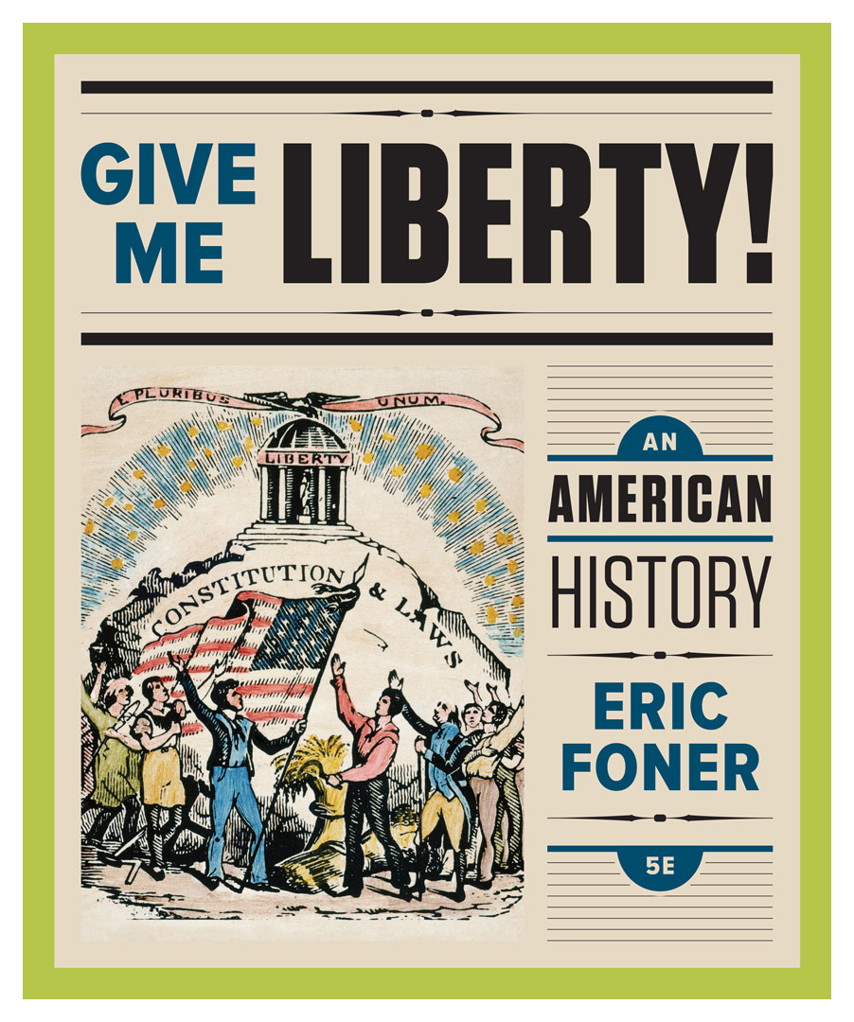
Lecture Slides
Give Me Liberty!
AN AMERICAN HISTORY
FIFTH EDITION
By Eric Foner

Slide 2
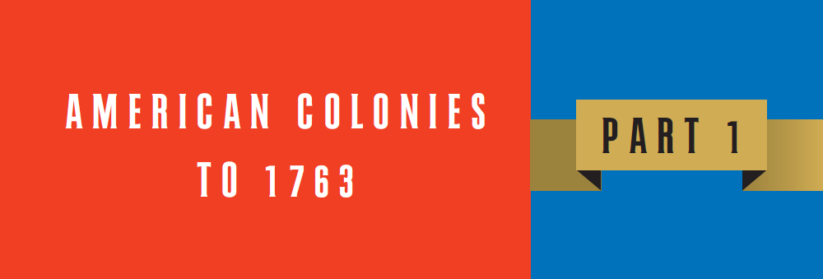
Part 1: American Colonies to 1763
Notes:
The colonial period was a time of enormous change, as the people of four continents―North America, South America, Europe, and Africa―were suddenly thrown into contact with one another. The period also initiated a new era of freedom, though freedom did not drive early Europe explorers who were instead seeking a trade route to Asia. European contact with the Americas soon developed into an imperial contest for power in which conquest, colonization, and resource exploitation dominated rival empires’ agendas. At the time of contact, the Western Hemisphere was home to tens of millions of people, and within the present borders of the United States existed Indian societies based on agriculture, hunting, or fishing, with distinct languages, religious practices, and governments. All of these societies experienced wrenching changes after contact, especially incorporation into a world market and epidemic diseases that devastated the population. Colonies that eventually formed the United States emerged in different ways: the first, Virginia, was established by a private company seeking profit through gold and transatlantic trade; Maryland and Pennsylvania were founded by individual proprietors holding royal land grants; New York was founded by the Dutch, and fell into British hands through war; and New England was founded by religious groups seeking to escape persecution. During the seventeenth century, the British colonies experienced social conflicts as groups battled for control, and relations with Indians were tense, and sometimes violent. Religious and political divisions in England, which experienced civil war in the 1640s and 1688, affected the colonies, as did wars between European rivals. Britain’s colonies experienced remarkable growth nonetheless, and by the eighteenth century, the non-Indian populations far outstripped their Spanish and French counterparts. Wealthy landowners and merchants dominated economic and political life, though emigration to the colonies continued to offer numerous opportunities to settlers not available in Europe, including the freedom to worship as they pleased, voting rights, access to land, and representation by elected assemblies that shared power with a governor usually appointed by London authorities. Though limited, this measure of self-government contrasted sharply with the Spanish and French empires, and drew thousands of English emigrants in the seventeenth century, as well as Irish, Scottish, and European emigrants during the eighteenth century. Yet the conditions that allowed these freedoms were made possible by lack of freedom for millions of others; American Indians were devastated by European diseases, driven off their lands, and enslaved by colonizers. Millions of Africans were uprooted and enslaved on plantations in Brazil, the Caribbean, and England’s North American colonies. Even among European immigrants, the majority arrived not completely free, but as indentured servants owing service in exchange for their passage. Modern ideas of freedom did not exist, or were highly different, in colonial America; women, non-whites, and the propertyless had far fewer rights than property-owning white males. Economic freedom, today associated with participation in an unregulated market, meant independence through ownership of land or a shop, or not relying on another for livelihood. Most colonies had official churches, many colonists seeking religious freedom denied it to others, and speaking or writing critically of public authority was often persecuted. Nonetheless, ideas about freedom played a major role in justifying colonization; Spanish and French colonizers claimed they were liberating American Indians by bringing civilization and Catholicism, while the British insisted freedom for Indians meant adopting English ways and Protestantism. English expansion also occurred at a time when freedom was seen as a defining characteristic of the nation. Slavery existed in every New World colony, and in many, formed the basis of economic life. Nonetheless, Britons prided themselves on “British liberty,” a common set of rights that protected against arbitrary governmental power. Thus, freedom and lack of freedom expanded together in the colonies of British North America that would eventually form the United States.

Slide 3
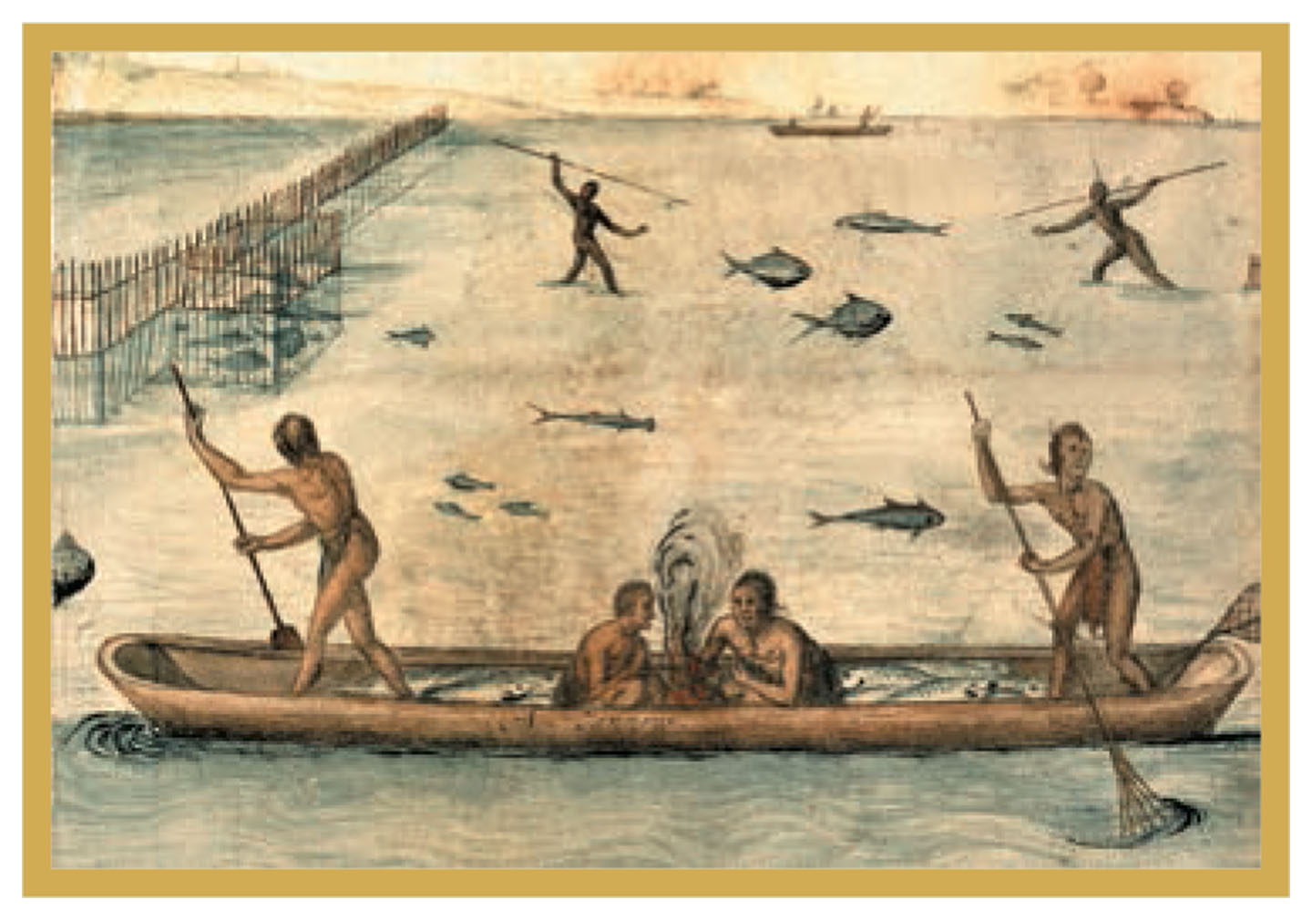
Depiction of American Indians fishing
Drawing by John White, 1585 Give Me Liberty!: An American History, 5th Edition
Copyright © 2017 W.W. Norton & Company
Notes:
Indians fishing, in a 1585 drawing by John White. The canoe is filled with fish, while two men harpoon others in the background. Among the wildlife illustrated are hammerhead sharks and catfish.

Slide 4
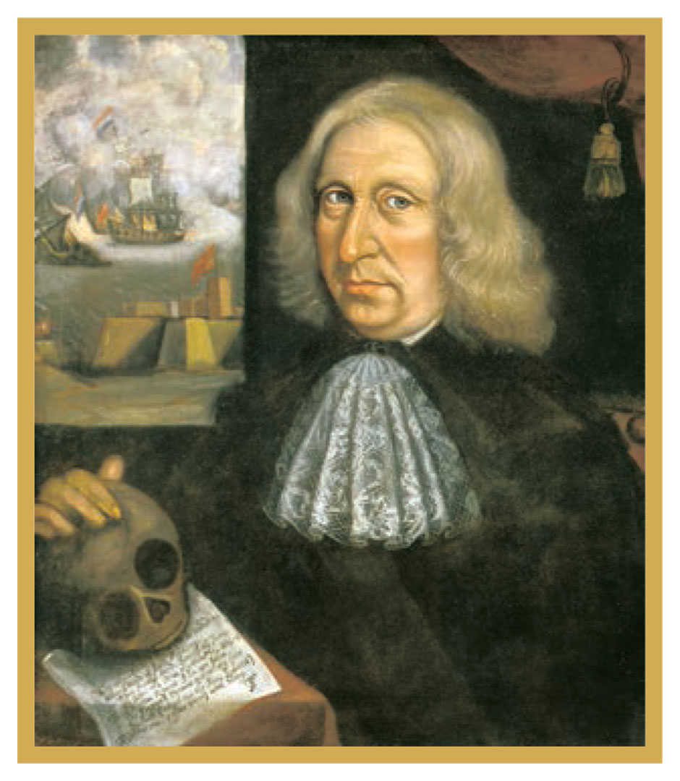
Thomas Smith
Self-Portrait, by Thomas Smith, ca. 1680 Give Me Liberty!: An American History, 5th Edition
Copyright © 2017 W.W. Norton & Company
Notes:
A self-portrait from around 1680, painted by Thomas Smith. A sailor who came to New England from Bermuda around 1650, Smith acquired considerable wealth, as evidenced by his fashionable clothing. The background depicts a naval battle involving Dutch and English ships (possibly a reference to their joint attack on a North African port in 1670). In the foreground is a poem with Smith’s initials. This is the earliest-known American self-portrait.

Slide 5
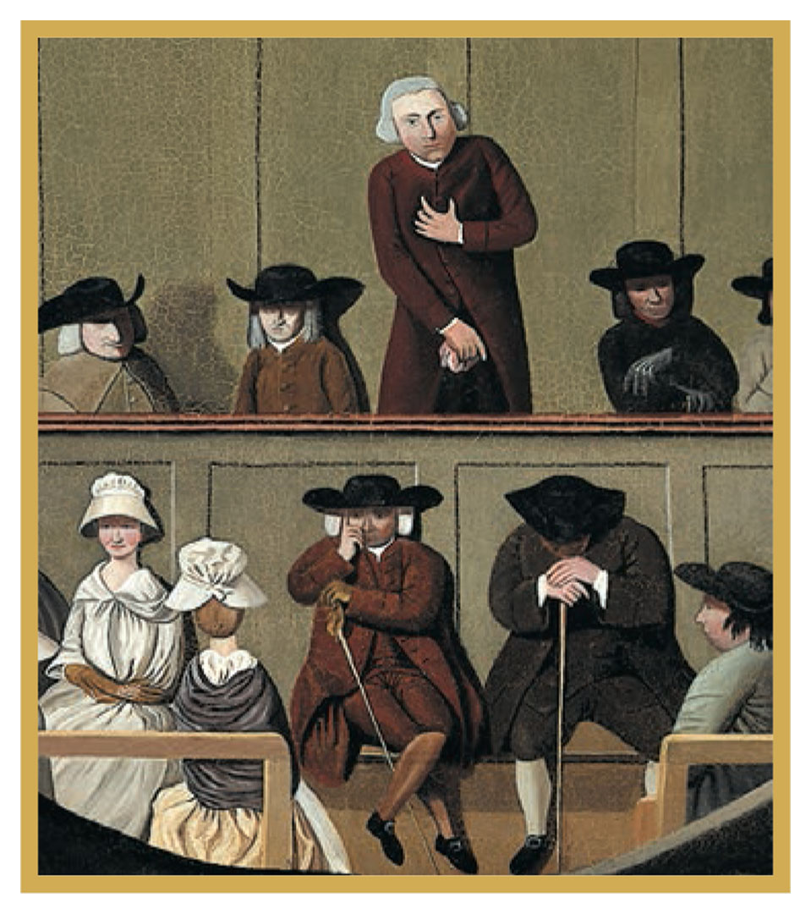
A Quaker Meeting
A Quaker Meeting, dating from the late-eighteenth Give Me Liberty!: An American History, 5th Edition
or early-nineteenth century Copyright © 2017 W.W. Norton & Company
Notes:
A Quaker Meeting, a painting by an unidentified British artist, dating from the late-eighteenth or early-nineteenth century. It illustrates the prominent place of women in Quaker gatherings.

Slide 6
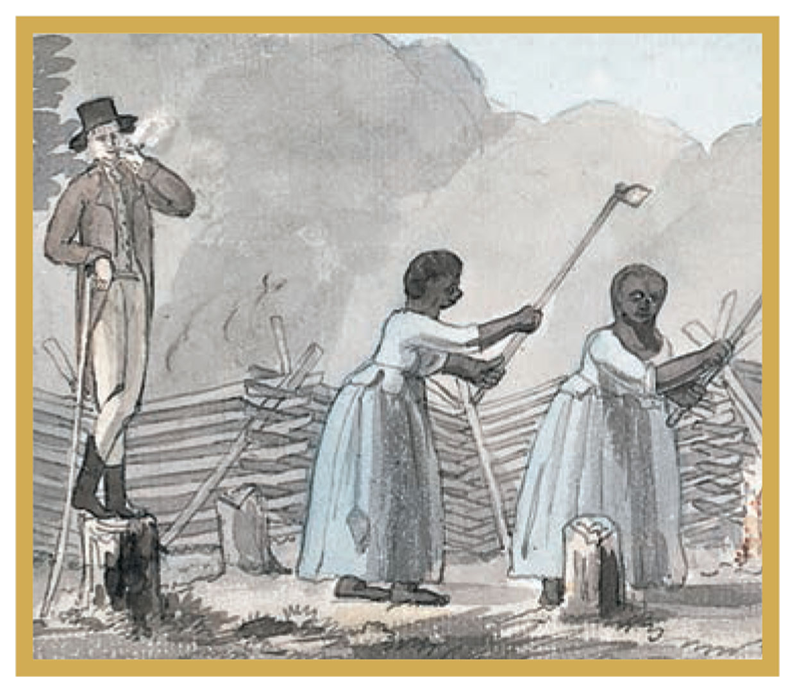
An Overseer Doing His Duty
An Overseer Doing His Duty, by Benjamin Latrobe, 1798 Give Me Liberty!: An American History, 5th Edition
Copyright © 2017 W.W. Norton & Company
Notes:
Benjamin Latrobe’s watercolor, An Overseer Doing His Duty, was sketched near Fredericksburg, Virginia, in 1798. The title is meant to be ironic: the well-dressed overseer relaxes while two female slaves work in the fields.

Slide 7
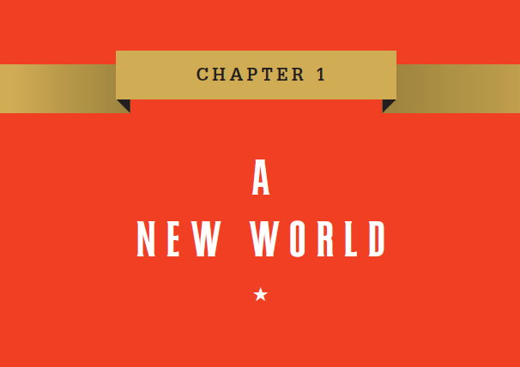
Chapter 1
Notes:
“The discovery of America,” the British writer Adam Smith announced in his celebrated work The Wealth of Nations (1776), was one of “the two greatest and most important events recorded in the history of mankind.” Historians no longer use the word “discovery” to describe European exploration, conquest, and colonization of a hemisphere already inhabited by millions, but there can be no doubt that Columbus’ 1492 landfall in the West Indian islands set in motion some of the most pivotal developments in human history. Immense changes soon followed in both the Old and New Worlds, the consequences of which are still with us today. The people of the Americas and Europe, previously unaware of each other’s existence, were thrown into continuous interaction; new crops crossed the Atlantic, reshaping diets and natural environments; and lacking immunity to European diseases, American Indian populations suffered devastating epidemics, the greatest population catastrophe in human history. Europeans found unfree labor in Africa, and between 1492 and 1820, about 7.7 million of approximately 10 million people to cross the Atlantic, were enslaved. From the vantage point of 1776, when the United States declared independence, it seemed to Adam Smith that America’s “discovery” produced great “benefits” and “misfortunes.” For western Europe, colonies brought “splendor and glory,” as well as an Atlantic trade that, according to Smith, enabled millions of Europeans to increase the “enjoyments” of life; to the “natives” of the Americas, it brought “dreadful misfortunes” and “every sort of injustice,” while for millions of Africans, it meant descent into slavery. Long before Columbus sailed, Europeans had dreamed of a land of abundance, riches, and ease beyond the western horizon, and once the “discovery” of this New World had taken place, they invented an America of the imagination, projecting onto it their hopes for a better life. Here, many believed, would arise unparalleled opportunities for riches, or at least liberation from poverty; envisioning a religious refuge, a society of equals, a source of power and glory, they searched for golden cities and fountains of eternal youth. Some sought to establish ideal communities based on the early Christian saints or other blueprints for social justice. Some of these dreams would be fulfilled, as America offered a far greater chance to own land and worship freely than existed in the rigidity and inequality of Europe. Yet what allowed millions to take control of their own destinies was made possible by the debasement of millions of others, as the New World became the site of many forms of unfree labor, opening new chapters in the long histories of freedom and slavery. A vast human diversity was thrown into contact in the New World, and exploration and settlement occurred in an era of near constant warfare in Europe; Native Americans and Africans consisted of numerous groups with their own languages and cultures, as likely to fight one another as to unite against European newcomers. All were changed by their integration into the new Atlantic economy, and complex interactions of Europeans, American Indians, and Africans would shape American history during the colonial era.

Slide 8
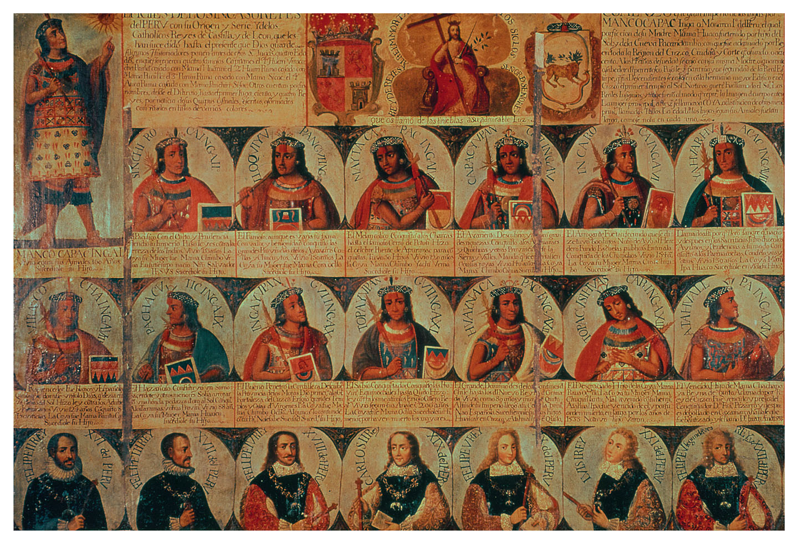
Genealogy of the Inca Rulers and
Their Spanish Successors
Genealogy of the Inca Rulers and Their Spanish Successors Give Me Liberty!: An American History, 5th Edition
Copyright © 2017 W.W. Norton & Company
Notes:
Painted around 1725, Genealogy of the Inca Rulers and Their Spanish Successors from Manco Capac, the First Inca King, to Ferdinand VI of Spain, depicts Spanish conquistadors and rulers as direct successors of Inca kings. The unknown artist aimed both to assimilate the pre-conquest history of the Americas into Spanish history and to legitimate Spain’s colonial rule over the former Inca empire.

Slide 9
Lecture Preview
The First Americans
Indian Freedom, European Freedom
The Expansion of Europe
Contact
The Spanish Empire
The French and Dutch Empires
Notes:
The subtopics for this lecture are listed on the screen above.

Slide 10
Focus Question: The First Americans
  Focus Question:
  What were the major patterns of Native American life in North America before Europeans arrived?
Notes:
The purpose of the focus questions is to help students find larger themes and structures to bring the historical evidence, events, and examples together for a connected thematic purpose.
As we go through each portion of this lecture, you may want to keep in mind how the information relates to this larger thematic question. Here are some suggestions: write the focus question in the left or right margin on your notes and as we go through, either mark areas of your notes for you to come back to later and think about the connection, OR as you review your notes later (to fill in anything else you remember from the lecture or your thoughts during the lecture or additional information from the readings), write small phrases from the lecture and readings that connect that information to each focus question AND/OR are examples that work together to answer the focus question.

Slide 11
The First Americans
The Settling of the Americas
Notes:
The first Americans to settle what eventually became the United States were culturally diverse, speaking hundreds of languages and living in various types of societies. They migrated by land over the Bering Strait or by sea anywhere from 15,000 to 60,000 years ago, some reaching the southern tip of South America perhaps 11,000 years ago. Facing a warming climate, and hunting animals such as the woolly mammoth and giant bison into extinction, these first settlers later developed agriculture, including the cultivation of maize (corn), squash, and beans. Emerging around 9,000 years ago, at approximately the same time as agriculture developed in the Near East, the practice allowed settled civilizations to be established.

Slide 12
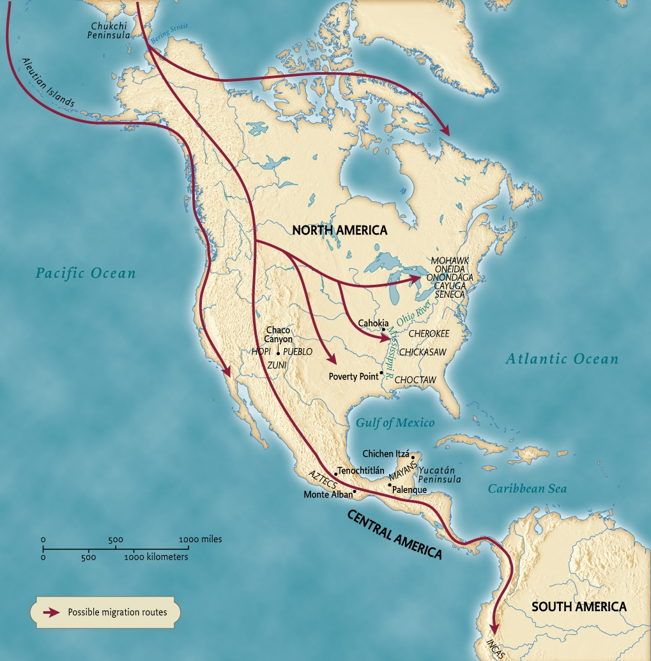
Beginnings of North American Settlement
Map 1.1 The First Americans Give Me Liberty!: An American History, 5th Edition
Copyright © 2017 W.W. Norton & Company
Notes:
A map illustrating the probable routes by which the first Americans settled the Western Hemisphere at various times between 15,000 and 60,000 years ago.

Slide 13
American Indian Societies
Indian Societies of the Americas
Mound Builders of the Mississippi River Valley
Western Indians
Indians of Eastern North America
Notes:
The diverse Indian societies of the Americas first encountered by the Europeans included civilizations with populations of several million people; large cities, road and irrigation systems; trade networks; and impressive architectural achievements. But even the most developed Indian civilizations, located in South America, lacked the technologies, such as metal tools and machines, gunpowder, and scientific knowledge needed for long-distance navigation, which contributed to the European ability to carry out and justify conquest. Nonetheless, American Indians had perfected farming and hunting techniques, established political power structures and religious belief, and engaged in long-distance trade.
In North America about 3,500 years ago, one native culture, the “mound builders,” centered their community in the lower Mississippi River valley around a series of semicircular mounds, and established extensive trade networks throughout the continent. For over 3,000 years, in what is now northeastern Arizona, the Hopi and Zuni and their ancestors lived in settled villages with irrigation, dam, and canal systems, and engaged in long-distance trade, becoming, after a period of decline, what the Spanish called the Pueblo Indians. The Pacific Coast was also densely populated by hundreds of independent groups of natives who lived primarily by fishing and gathering food, and on the Great Plains, many Indians hunted the buffalo herds, while others lived in agricultural villages. In eastern North America, hundreds of tribes, from the Choctaw, Cherokee, and Chickasaw in the southeast to the Iroquois peoples of the northeast―who formed the Great League of Peace―lived by hunting, fishing, gathering, and agriculture, and engaged each other in trade, diplomacy, and, occasionally, war. When Europeans arrived, native peoples were tremendously diverse and differentiated by language, custom, political system, and religious belief. They did not consider themselves a single unified people with a common cultural or racial identity, nor did they possess a sense of “America” as a continent or hemisphere.

Slide 14
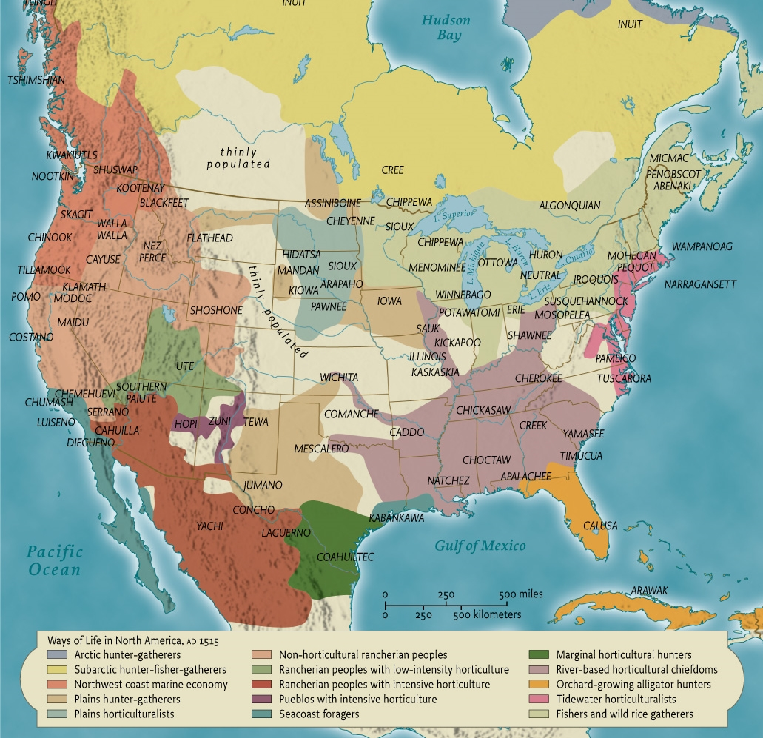
Native Ways of Life
Map 1.2 Native Ways of Life, ca. 1500 Give Me Liberty!: An American History, 5th Edition
Copyright © 2017 W.W. Norton & Company
Notes:
The native population of North America at the time of first contact with Europeans consisted of numerous tribes with their own languages, religious beliefs, and economic and social structures. This map suggests the numerous ways of life existing at the time.

Slide 15
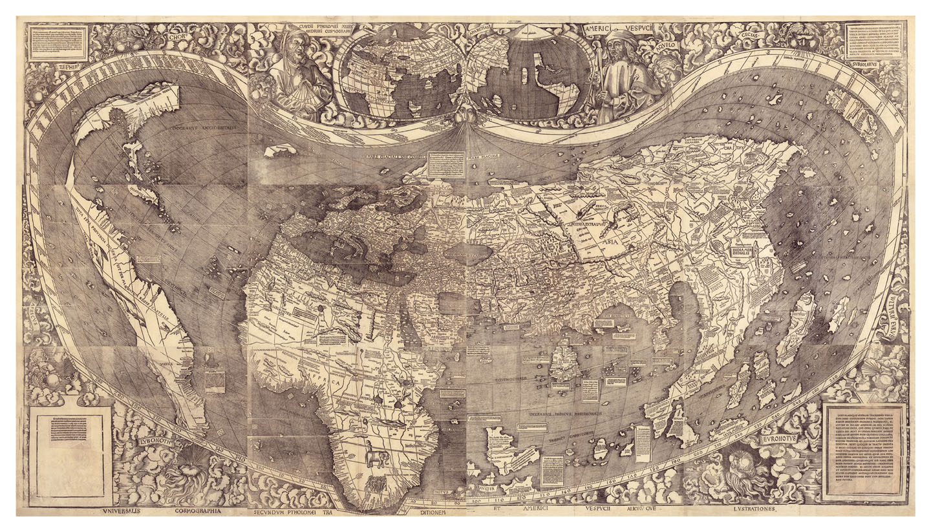
Map of Western Hemisphere, 1507
World Map, Martin Waldseemoller, 1507 Give Me Liberty!: An American History, 5th Edition
Copyright © 2017 W.W. Norton & Company
Notes:
This world map, produced in 1507 by the German mapmaker Martin Waldseemoller, was the first to depict the full Western Hemisphere and the first to include the name “America” (on the lower part of South America) for part of the New World. It also seems to indicate the Pacific Ocean, but no European encountered that ocean until the Spanish explorer Balboa in 1513.

Slide 16
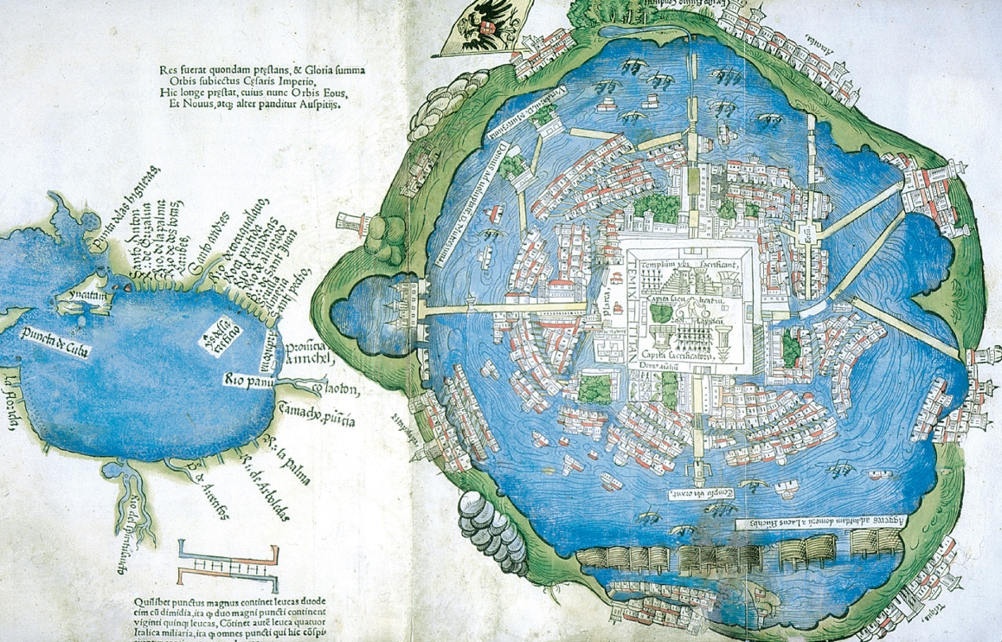
Aztec Capital
Map of the Aztec Capital, Tenochtitlán Give Me Liberty!: An American History, 5th Edition
Copyright © 2017 W.W. Norton & Company
Notes:
Map of the Aztec capital Tenochtitlán and the Gulf of Mexico, probably produced by a Spanish conquistador and published in 1524 in an edition of the letters of Hernán Cortés. The map shows the city’s complex system of canals, bridges, and dams, with the Great Temple at the center. Gardens and a zoo are also visible.

Slide 17
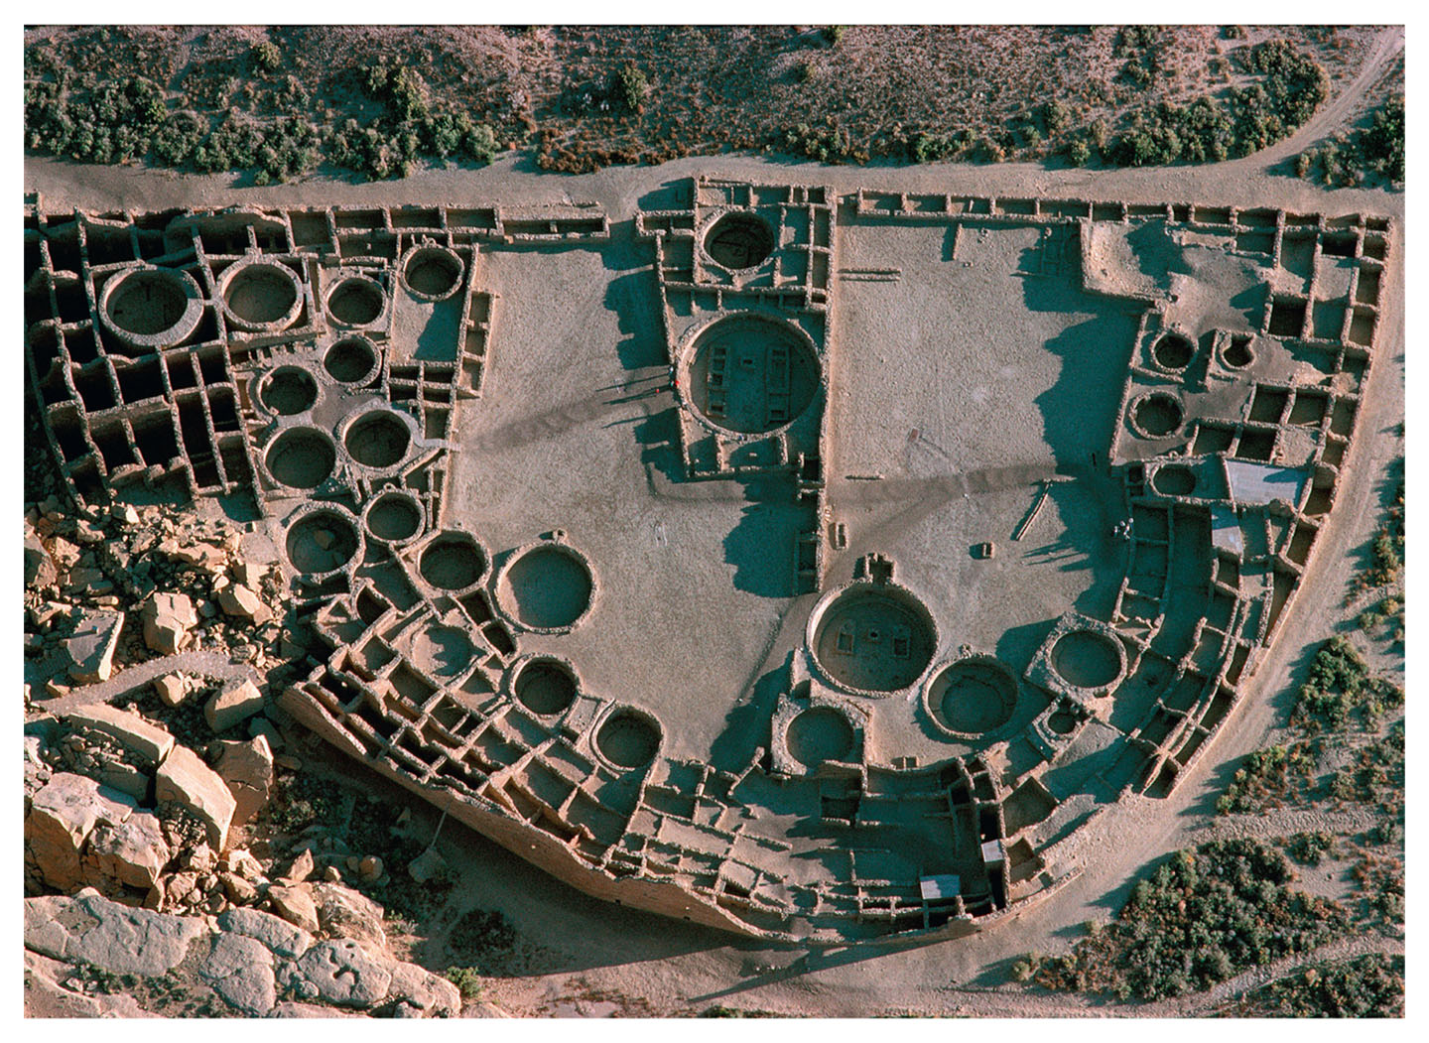
Pueblo Bonita
A modern aerial photograph of the ruins of Pueblo Bonita Give Me Liberty!: An American History, 5th Edition
Copyright © 2017 W.W. Norton & Company
Notes:
A modern aerial photograph of the ruins of Pueblo Bonita, in Chaco Canyon in present-day New Mexico
The rectangular structures are the foundations of dwellings, and the circular ones are kivas, or places of religious worship.

Slide 18
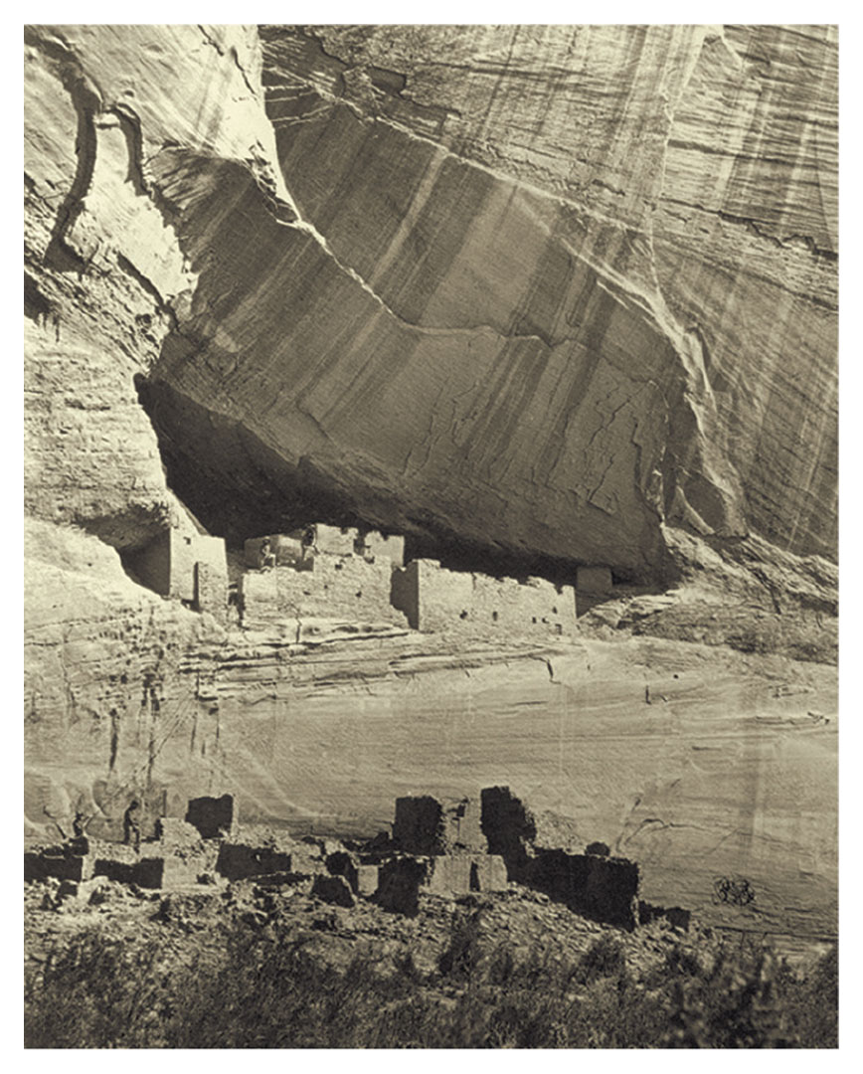
Cliff Dwellings
Cliff dwellings in Cañon de Chelly, modern-day Arizona Give Me Liberty!: An American History, 5th Edition
Copyright © 2017 W.W. Norton & Company
Notes:
Cliff dwellings in Cañon de Chelly, in the area of modern-day Arizona, built sometime between 300 and 1300 and photographed in 1873

Slide 19
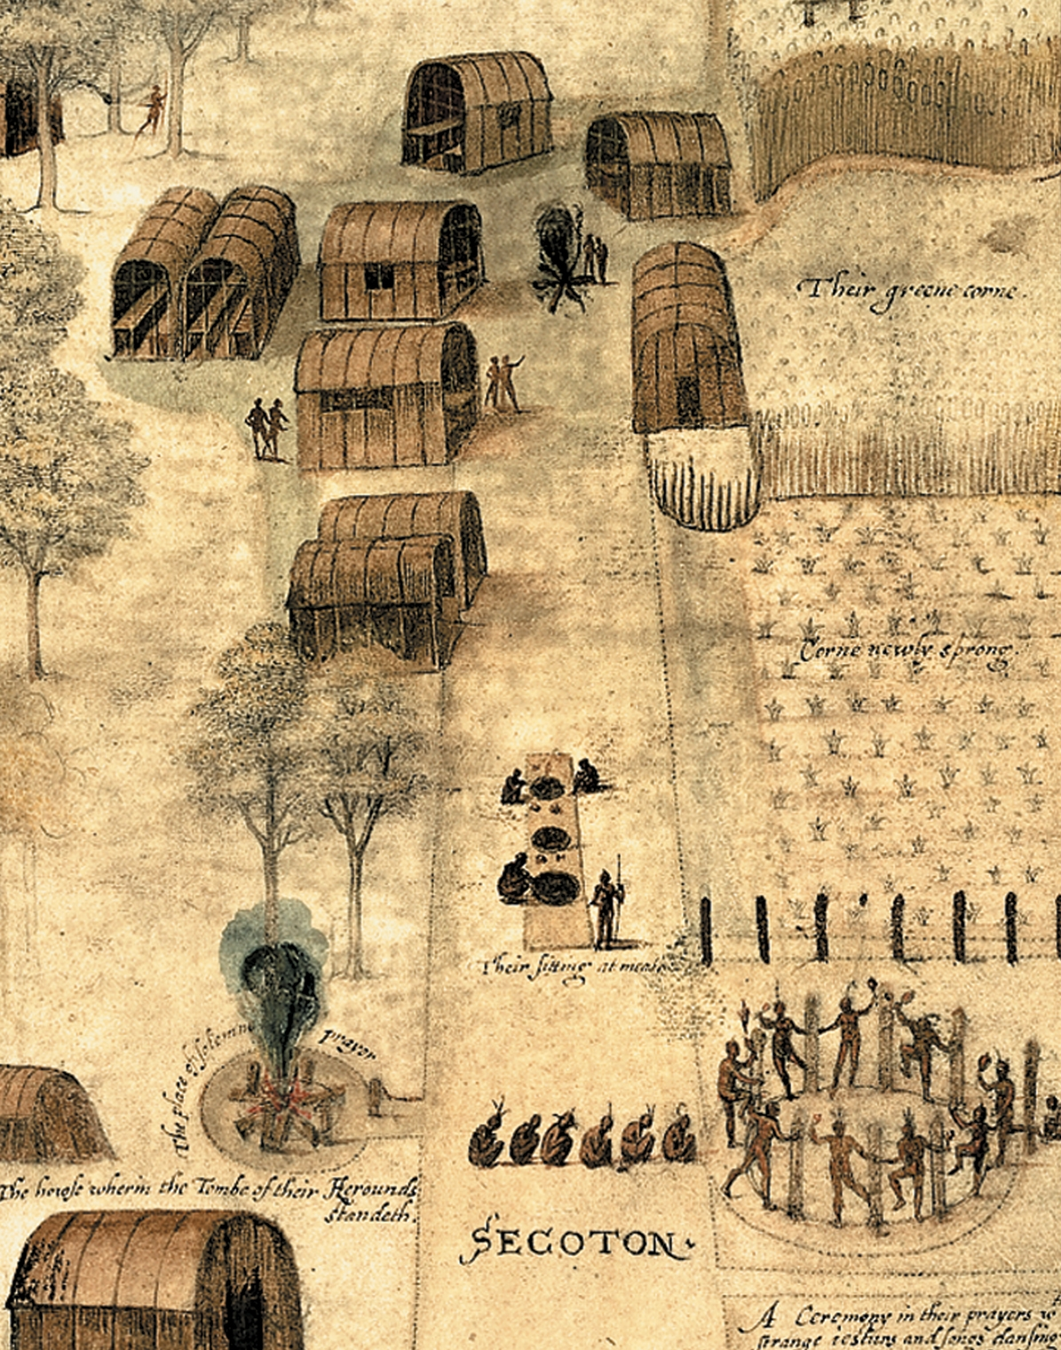
Secoton
The Village of Secoton, by John White Give Me Liberty!: An American History, 5th Edition
Copyright © 2017 W.W. Norton & Company
Notes:
The Village of Secoton, by John White, an English artist who spent a year on the Outer Banks of North Carolina in 1585–1586 as part of an expedition sponsored by Sir Walter Raleigh. A central street links houses surrounded by fields of corn. In the lower part, dancing Indians take part in a religious ceremony.

Slide 20
Religion, Land, and Gender Roles
Native American Religion
Land and Property
Gender Relations
Notes:
Despite their diversity, North American Indian societies did have some common characteristics. Their religions and religious practices were often directly related to farming and hunting; plants, animals, and nonliving things, such as water and wind, were invested with spiritual power; distinct ideas of defined membership also developed within and across communities. Each Indian society respected and gave authority to shamans, medicine men, and other religious leaders who seemed to have spiritual or supernatural powers. While most of their religions, like those of Europe, held that a single creator was at the top of the spiritual order, they did not distinguish sharply between the natural and supernatural or the secular and religious.
Unlike the Europeans, North American Indian societies did not treat land as a commodity to be owned privately by individuals, but instead had family- and communal-based notions of property. Although tribes and groups had systems of social status, Indians did not devote themselves to accumulating wealth and material goods, and Indian trading was as much a social and cultural practice, emphasizing generosity and gift-giving, as an economic exchange.
Relations between men and women were also markedly different from those of Europeans. Most but not all North American Indian societies were matrilineal, and in some groups it was possible for women to own property, engage in premarital sex, divorce their husbands, take part in religious ceremonies, and help select male tribal leaders. Men assumed political leadership, and proved their masculinity by engaging in hunting, agriculture, or warfare.

Slide 21
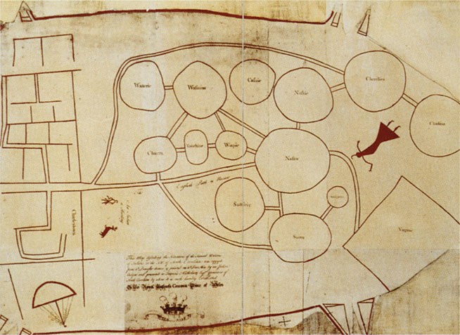
Indian and European Conceptions of Property
A Catawba map illustrates the differences between Indian Give Me Liberty!: An American History, 5th Edition
and European conceptions of landed property. Copyright © 2017 W.W. Norton & Company
Notes:
A Catawba map illustrates the differences between Indian and European conceptions of landed property. The map depicts not possession of a specific territory, but trade and diplomatic connections between various native groups and with the colony of Virginia, represented by the rectangle on the lower right. The map, inscribed on deerskin, was originally presented by Indian chiefs to Governor Francis Nicholson of South Carolina in 1721. This copy, the only version that survives, was made by the governor for the authorities in London. It added English labels that conveyed what the Indians had related orally with the gift.

Slide 22
European Perceptions of the First Americans
European Views of the Indians
Notes:
Europeans first tended to see Indians as either “noble savages” or uncivilized and brutal inferior barbarians. Over time, negative images of the Indians came to dominate Europeans’ views of indigenous peoples, with Europeans focusing on natives’ apparent lack of religion, land-use practices, and gender relations as the basis for their relative inferiority. Indians were seen as devilish heathens, as people who didn’t use the land properly (which in the eyes of the English, French, and Dutch, justified their expropriation of the land), and as people who subverted European gender roles by allowing weak men to engage in “leisure” activities like hunting and fishing, leaving agricultural work to native women, who, Europeans believed, belonged in the home. Europeans connected women’s agricultural labor to a lack of freedom, and men’s hunting to laziness and weakness.

Slide 23
American Indian Life
Drawing by John White, 1585 Give Me Liberty!: An American History, 5th Edition
Copyright © 2017 W.W. Norton & Company
Notes:
Indians fishing, in a 1585 drawing by John White. The canoe is filled with fish, while two men harpoon others in the background. Among the wildlife illustrated are hammerhead sharks and catfish.

Slide 24
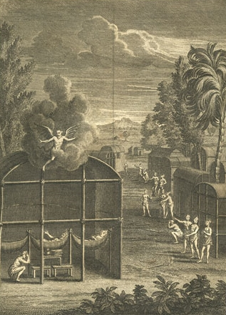
Jesuit Portrayal of American Indian Religion
A seventeenth-century engraving by a French Jesuit priest illustrates Give Me Liberty!: An American History, 5th Edition
many Europeans’ views of Indian religion. Copyright © 2017 W.W. Norton & Company
Notes:
A seventeenth-century engraving by a French Jesuit priest illustrates many Europeans’ view of Indian religion. A demon hovers over an Iroquois longhouse, suggesting that Indians worship the devil.

Slide 25
Focus Question: Indian Freedom,
European Freedom
  Focus Question:
  How did Indian and European ideas of freedom differ on the eve of contact?
Notes:
The purpose of the focus questions is to help students find larger themes and structures to bring the historical evidence, events, and examples together for a connected thematic purpose.
As we go through each portion of this lecture, you may want to keep in mind how the information relates to this larger thematic question. Here are some suggestions: write the focus question in the left or right margin on your notes and as we go through, either mark areas of your notes for you to come back to later and think about the connection, OR as you review your notes later (to fill in anything else you remember from the lecture or your thoughts during the lecture or additional information from the readings), write small phrases from the lecture and readings that connect that information to each focus question AND/OR are examples that work together to answer the focus question.

Slide 26
Different Ideas of Freedom
Indian Freedom
Notes:
Some Europeans saw Native Americans as embodying freedom and liberty as Europeans understood the terms, but most soon thought that such notions of “freedom” were foreign to native societies. Europeans believed that Indians were savages in part because they did not seem to have governments or legal systems, lacking the respect for authority, discipline, and order that Europeans believed marked their civilizations. The modern idea of freedom as personal independence, often based on the ownership of private property, meant little in most Indian societies. But Indians had their own ideas of freedom, as is evident in the practice of small-scale slavery in some Indian groups (although buying and selling slaves was unknown), and in their resistance to enslavement by Europeans.
Although Indians respected individual thought and judgment that conflicted with group decisions, Indians generally emphasized commitment to family and community, group autonomy and self-determination, and mutual obligations accompanied by belonging and connectedness over individual freedom.

Slide 27
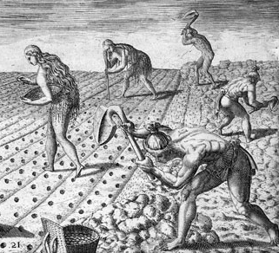
Gender and Work
Indian men and women tending a crop. Give Me Liberty!: An American History, 5th Edition
Copyright © 2017 W.W. Norton & Company
Notes:
Indian women planting crops while men break the sod. An engraving by Theodor de Bry, based on a painting by Jacques Le Moyne de Morgues. Morgues was part of an expedition of French Huguenots to Florida in 1564; he escaped when the Spanish destroyed the outpost in the following year.

Slide 28
Liberty and Authority
Christian Liberty
Freedom and Authority
Liberty and Liberties
Notes:
When Europeans colonized the New World, they had multiple ideas of freedom as a collection of rights and privileges, many of which were reserved for a small portion of the population. One important idea of freedom was religious or moral, based on an individual’s decision to subordinate himself to the Christian God. This was not the same as modern notions of religious freedom or tolerance. Each European country had an established church, and their governments often suppressed or heavily regulated other Christian and non-Christian groups.
Secular ideas of freedom located liberty in individual obedience to law and acceptance of one’s rank and its duties within a rigid and extensive social hierarchy, ranging from urban poor and rural peasants at the bottom, to church officials, hereditary aristocrats and nobles, and kings and other members of monarchies at the top. Inequality was built into all social relations; the king ruled by divine right, and superiors demanded deference from their social inferiors. In families, men had authority over their “dependent” women and children, whose legal identities were subsumed by that of the male. Women could not own property, control their wages, write separate wills, or even—in most cases—divorce, and husbands had rights to their wives’ labor and bodies.
Few men enjoyed the freedom derived from economic independence, usually land ownership, and property qualifications for voting meant that few men could vote. Modern civil liberties such as freedom of religion and speech did not exist. Workers who defied employers and labor contracts suffered harsh criminal penalties. Yet each European country that colonized the New World claimed to be spreading freedom for themselves and the Indians.

Slide 29
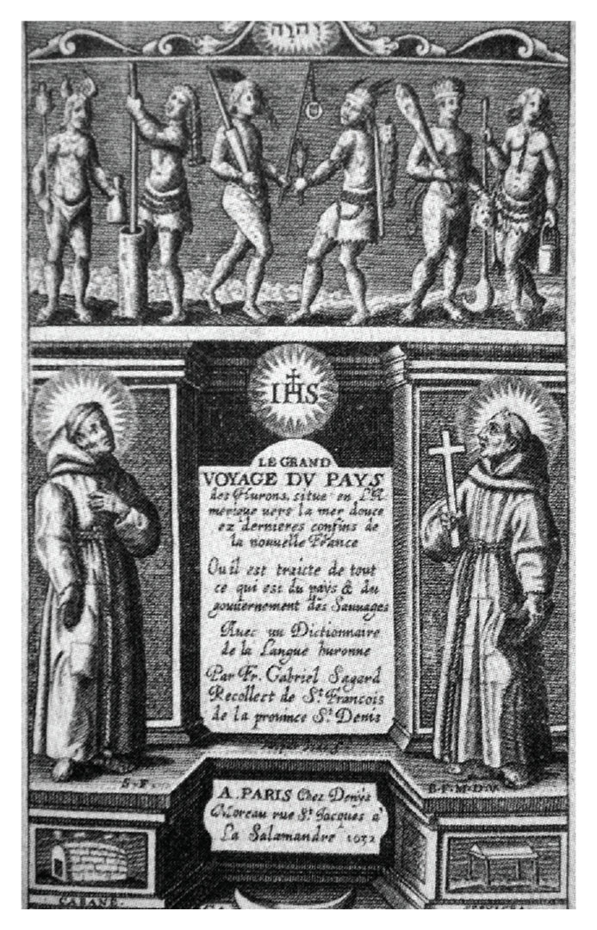
The Great Voyage to the Country of the Hurons
The Great Voyage to the Country of the Hurons Give Me Liberty!: An American History, 5th Edition
Copyright © 2017 W.W. Norton & Company
Notes:
The title page of The Great Voyage to the Country of the Hurons, published in Paris in 1632 by Gabriel Sagard, one of the first missionaries to New France, includes images of Native Americans and Catholic friars. Father Sagard also produced a dictionary of the Huron language.

Slide 30
Focus Question: The Expansion of Europe
  Focus Question:
  What impelled European explorers to look west across the Atlantic?
Notes:
The purpose of the focus questions is to help students find larger themes and structures to bring the historical evidence, events, and examples together for a connected thematic purpose.
As we go through each portion of this lecture, you may want to keep in mind how the information relates to this larger thematic question. Here are some suggestions: write the focus question in the left or right margin on your notes and as we go through, either mark areas of your notes for you to come back to later and think about the connection, OR as you review your notes later (to fill in anything else you remember from the lecture or your thoughts during the lecture or additional information from the readings), write small phrases from the lecture and readings that connect that information to each focus question AND/OR are examples that work together to answer the focus question.

Slide 31
European Voyages
Chinese and Portuguese Navigation
Portugal and West Africa
Freedom and Slavery in Africa
The Voyages of Columbus
Notes:
Europeans “discovered” the Americas only because they were interested in finding a sea route to India, China, and the islands of the East Indies, which had long been the basis of a lucrative land-based trade in silk, tea, spices, porcelain, and other luxury goods. In the early fifteenth century, a large Chinese naval expedition intended to show China’s power went all the way to East Africa and could have gone farther west to the Americas, but the Chinese were uninterested in establishing a maritime empire.
The Portuguese, benefiting from new sailing/navigation techniques, first explored the Atlantic by making their way down the western coast of Africa. Sailing in recently developed ships called “caravels” that were capable of long-distance travel, they encountered powerful African kingdoms as they made their way south. Along the way, they also began establishing small colonies on islands in the Atlantic off the African coast—the first sugar plantations based on slavery in the Atlantic world. Furthermore, sailors hoped to find the African source of the gold trade that had provided Europe with most of its supply of the precious metal. By 1498, the Portuguese had explored the Indian coast, and they soon established a maritime empire with trading outposts throughout Africa, India, southern China, and Indonesia.
Until 1434, Europeans had never seen the coast of Sub-Saharan Africa, including the forest kingdoms south of Mali that were the source of the gold trade. A Portuguese ship that returned with a sprig of rosemary from West Africa proved that the trip could be made. By 1485, they reached Benin, and began establishing fortified trading posts called “factories,” in reference to the merchants there called “factors.” That trade activity inspired other European nations to follow soon thereafter. In addition to outposts on the continent, the Portuguese colonized many of the islands off the coast where they would establish sugar plantations worked by native and African slaves.
Although slavery existed in Africa before the Europeans came, Africans enslaved other Africans who were criminals, debtors, or captives in war. They worked in households and families, had some rights, and could become free. African slavery was only one of several forms of labor and was not the basis of African economies. With the Portuguese and other Europeans in Africa by the end of the fifteenth century, slavery became purely economic, and a large, accelerated slave trade developed within and beyond Africa. During the last half of the fifteenth century, at least 100,000 slaves were transported to Spain and Portugal, and in 1502, the first slaves were taken to the Caribbean. After reaching West Africa, Portuguese explorers pushed farther south. Bartholomeu Dias reached the Cape of Good Hope in 1487, and Vasco da Gama rounded it to India in 1498. The route replaced the Italian city-states as the primary hub of trade with the East only shortly after Columbus discovered what he believed to be a new westerly route to India.
Columbus was a seasoned Mediterranean and North Atlantic sailor from Genoa, who unlike popular belief, knew the Earth was round, only he underestimated its size. Europeans were unaware of the massive American continents between Europe and Asia; brief Viking travels to North America had been forgotten in all but Norse legend shortly after their outposts were abandoned. Columbus was motivated by religious and economic motives; he hoped to convert Asian peoples to Christianity, and renew European efforts to retake Jerusalem from Muslim control. Though he had trouble gaining financial support for his travels, King Ferdinand and Queen Isabella of the newly united Spain decided to back his venture after completion of the “Reconquista,” in which the Moors were driven from Spain. He sailed with royal letters granting permission to make trade agreements with Asian rulers, and endorsements from bankers and merchants, all of whom desired to circumvent Muslim trade monopolies with the east.

Slide 32
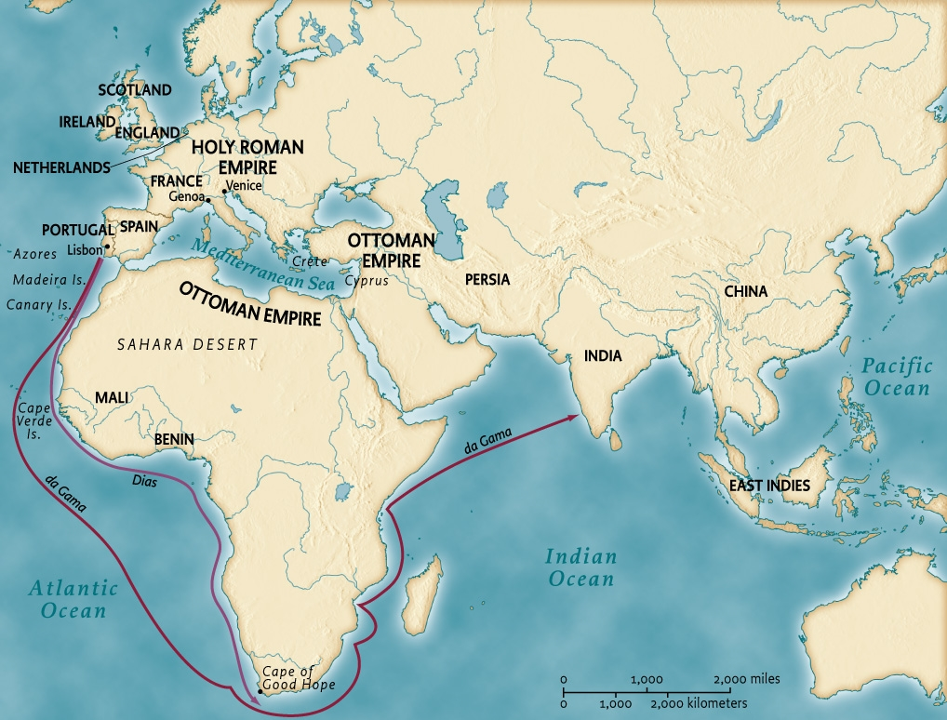
The World Known to Europeans in the
Fifteenth Century
Map 1.3 The old world on the eve of American colonization, ca. 1500 Give Me Liberty!: An American History, 5th Edition
Copyright © 2017 W.W. Norton & Company
Notes:
In the fifteenth century, the world known to Europeans was limited to Europe, parts of Africa, and Asia. Explorers from Portugal sought to find a sea route to the East in order to circumvent the Italian city-states and Middle Eastern rulers who controlled the overland trade.

Slide 33
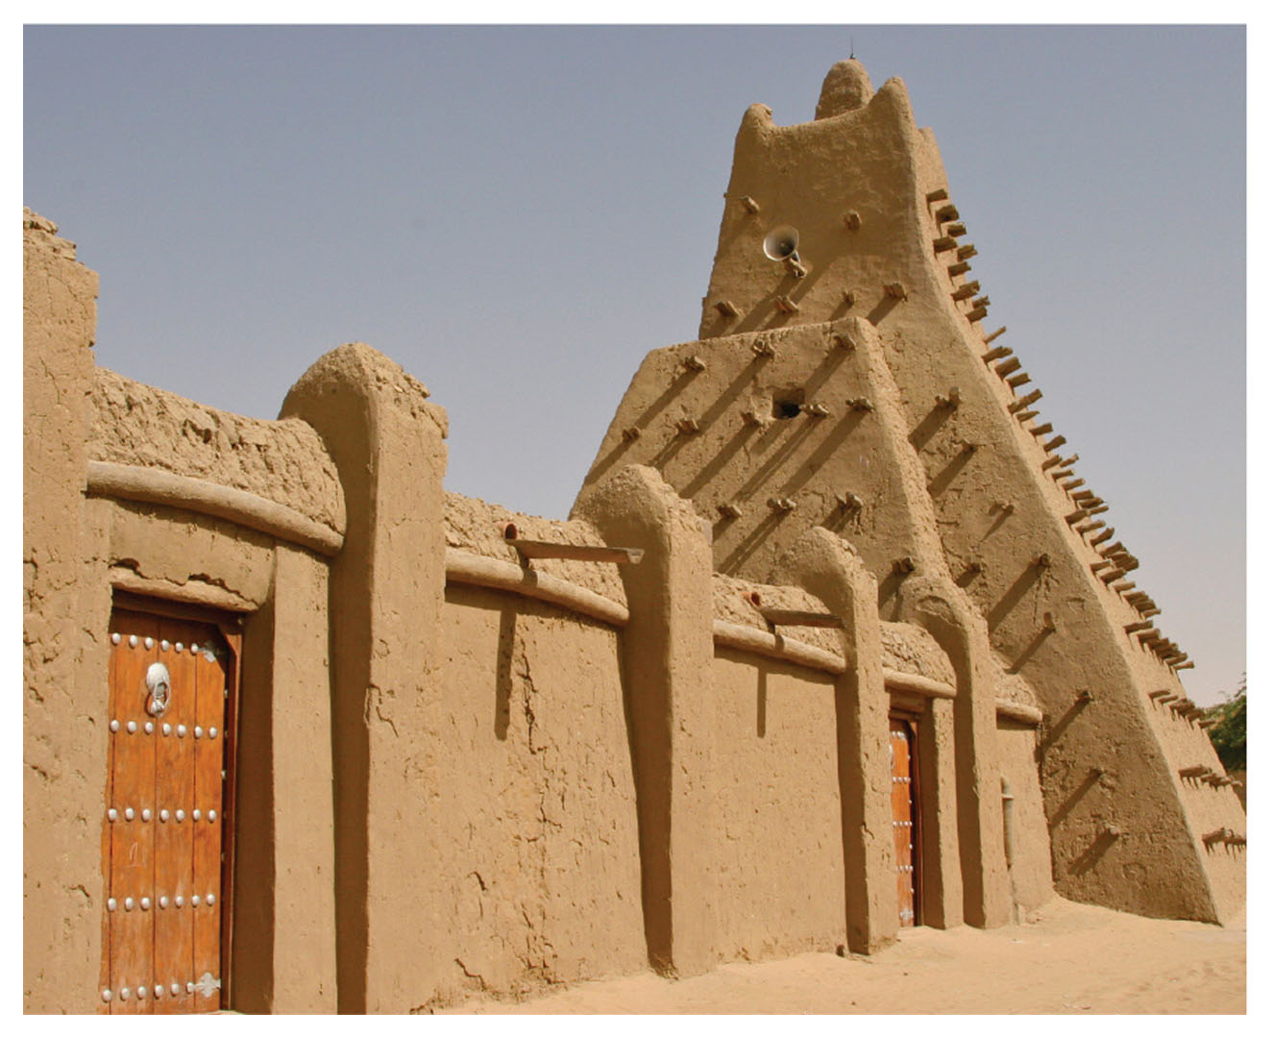
Sankore University
Sankore University in Timbuktu Give Me Liberty!: An American History, 5th Edition
Copyright © 2017 W.W. Norton & Company
Notes:
Sankore University in Timbuktu, in present-day Mali, was one of the great Islamic centers of learning in fourteenth-century Africa.

Slide 34
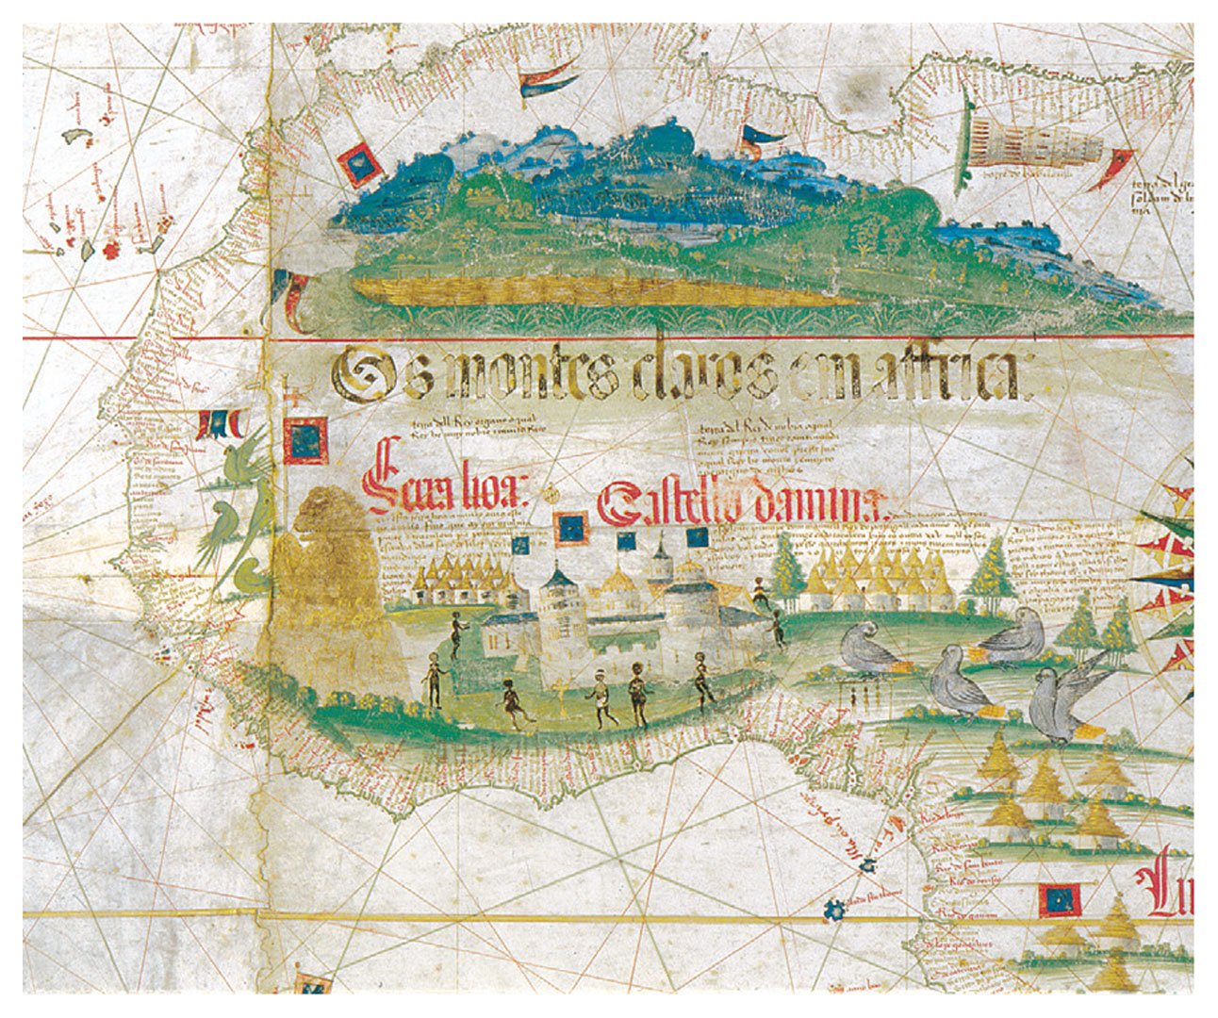
West Coast of Africa: Cantino World Map
Detail from Cantino World Map Give Me Liberty!: An American History, 5th Edition
Copyright © 2017 W.W. Norton & Company
Notes:
A detail from the Cantino World Map depicting the western coast of Africa at the beginning of the Atlantic slave trade. Created by an anonymous Portuguese mapmaker in 1502, the map included Europe, Africa, and a small part of the Western Hemisphere, described as “the islands lately discovered in the parts of India.” It was smuggled out of Portugal by Alberto Cantino, a diplomat representing an Italian city-state.

Slide 35
Focus Question: Contact
  Focus Question:
  What happened when the peoples of the Americas came in contact with Europeans?
Notes:
The purpose of the focus questions is to help students find larger themes and structures to bring the historical evidence, events, and examples together for a connected thematic purpose.
As we go through each portion of this lecture, you may want to keep in mind how the information relates to this larger thematic question. Here are some suggestions: write the focus question in the left or right margin on your notes and as we go through, either mark areas of your notes for you to come back to later and think about the connection, OR as you review your notes later (to fill in anything else you remember from the lecture or your thoughts during the lecture or additional information from the readings), write small phrases from the lecture and readings that connect that information to each focus question AND/OR are examples that work together to answer the focus question.

Slide 36
Columbus in the New World
Columbus in the New World
Exploration and Conquest
The Demographic Disaster
Notes:
After only 33 days at sea, Columbus, on October 12, 1492, arrived at the Bahamas; the exact landing site continues to be disputed, but was most likely San Salvador. He soon went on to Hispaniola (now Haiti and the Dominican Republic) and Cuba. He brought back ten natives, whom he called “Indians,” to Spain for conversion to Christianity. The next year saw Columbus return with more ships and men and the beginnings of Spanish colonization of the New World. Another Italian explorer, Amerigo Vespucci explored the coast of South America between 1499 and 1502, clearly demonstrating that a new continent had been discovered, a continent that would come to bear his name. Vespucci realized that the inhabitants were not residents of the East Indies, but the name “Indians” has endured to the present-day.
A host of explorers and fishermen from other European nations, including England, France, and Portugal, soon came to the Americas; John Cabot, a Genoese merchant settled in England, reached Newfoundland in 1497, and Pedro Cabral claimed Brazil for Portugal in 1500. But Spanish conquistadores such as Hernán Cortés and Francisco Pizarro took the lead in conquering the Americas, including large native civilizations in South America, for national glory, wealth, and Catholicism, devastating these cultures through warfare, and primarily disease exposure, thus laying the basis for the gold and silver mines that would enrich the Spanish crown. In 1513, Vasco Nuñez Balboa became the first to cross Panama and see the Pacific Ocean. Ferdinand Magellan led the first expedition around the globe, encountering islands in the Pacific previously unknown to Europeans.
The transatlantic flow of goods and people mixed millions of years of separate evolution, throwing together plants, animals, and cultures. This “Columbian exchange” transformed both Europe and the Americas. But the impact of war, enslavement, and especially diseases introduced by the Europeans was a demographic disaster for native peoples of the New World, whose population fell dramatically. In the 150 years since European contact, perhaps 80 million Indians—nearly one-fifth of humankind at that time—died.

Slide 37
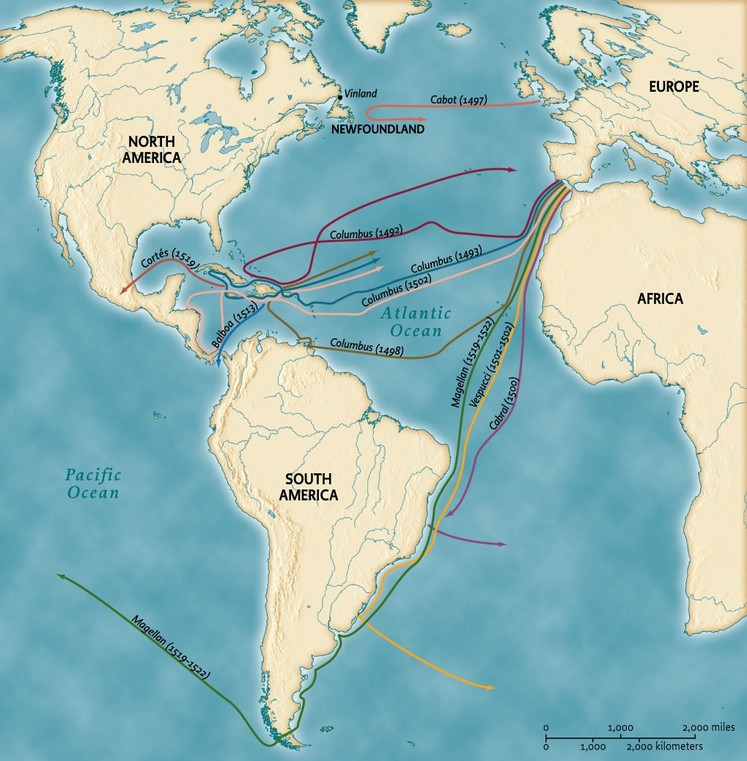
Initial European Voyages
Map 1.4 Voyages of Discovery Give Me Liberty!: An American History, 5th Edition
Copyright © 2017 W.W. Norton & Company
Notes:
Christopher Columbus’s first Atlantic crossing, in 1492, was soon followed by voyages of discovery by English, Portuguese, Spanish, and Italian explorers.

Slide 38
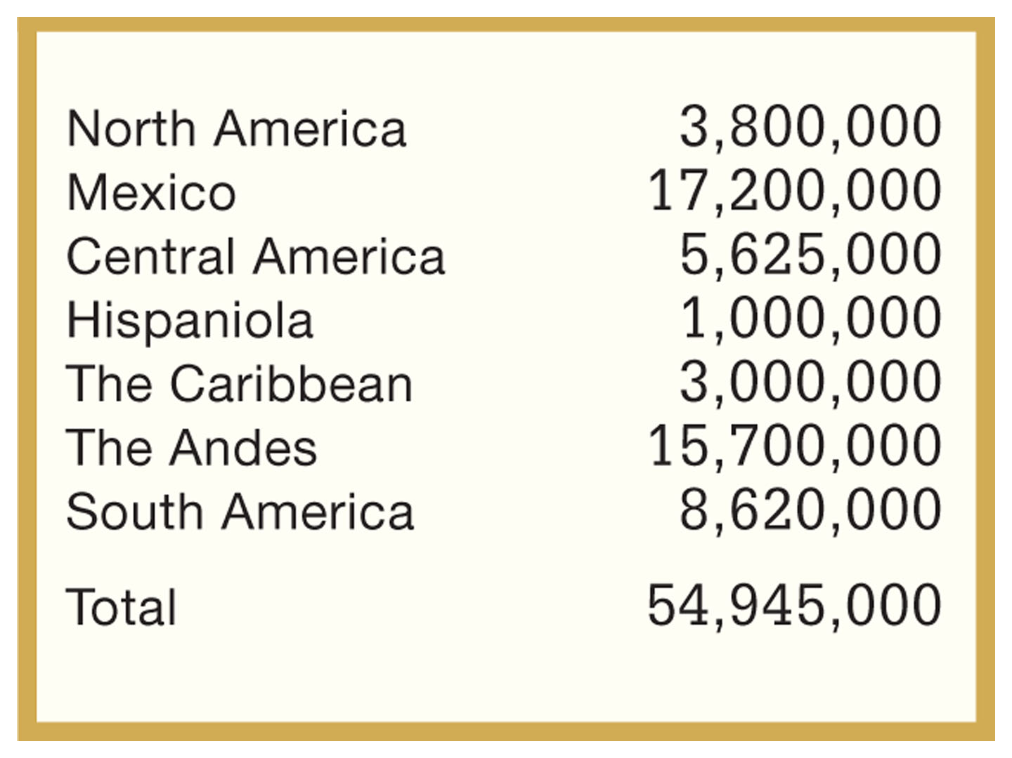
The Demographic Disaster
Table 1.1 Estimated Regional Populations:The Americas, ca. 1500 Give Me Liberty!: An American History, 5th Edition
Copyright © 2017 W.W. Norton & Company

Slide 39
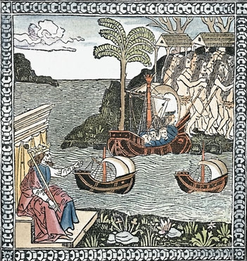
Columbus’s Landfall
Engraving from La lettera dell’isole (Letter from the Islands), 1493 Give Me Liberty!: An American History, 5th Edition
Copyright © 2017 W.W. Norton & Company
Notes:
Columbus’s Landfall, an engraving from La lettera dell’isole (Letter from the Islands)
This 1493 pamphlet reproduced, in the form of a poem, Columbus’s first letter describing his voyage of the previous year. Under the watchful eye of King Ferdinand of Spain, Columbus and his men land on a Caribbean island, while local Indians flee.

Slide 40
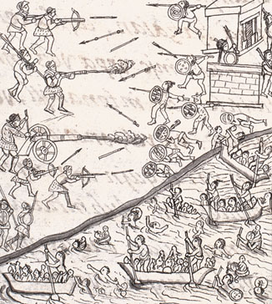
Cortés Marches on Tenochtitlán
Engravings, from the Florentine Codex Give Me Liberty!: An American History, 5th Edition
Copyright © 2017 W.W. Norton & Company
Notes:
Engravings, from the Florentine Codex, of the forces of Cortés marching on Tenochtitlán and assaulting the city with cannon fire. The difference in military technology between the Spanish and Aztecs is evident. Indians who allied with Cortés had helped him build vessels and carry them in pieces over mountains to the city. The codex (a volume formed by stitching together manuscript pages) was prepared under the supervision of a Spanish missionary in sixteenth-century Mexico.

Slide 41
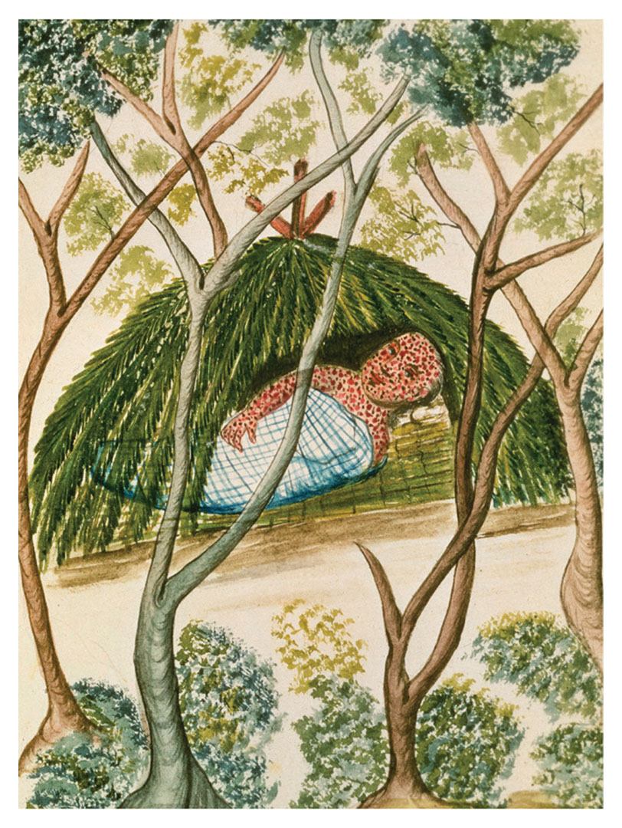
Indian Suffering from Smallpox
Drawing showing Indian suffering from smallpox, ca. 1700 Give Me Liberty!: An American History, 5th Edition
Copyright © 2017 W.W. Norton & Company
Notes:
A drawing from around 1700 shows an Indian suffering from smallpox. The Columbian Exchange―the flow of goods and people across the Atlantic―included animals, plants, technology, and diseases.

Slide 42
Focus Question: The Spanish Empire
  Focus Question:
  What were the chief features of the Spanish empire in America?
Notes:
The purpose of the focus questions is to help students find larger themes and structures to bring the historical evidence, events, and examples together for a connected thematic purpose.
As we go through each portion of this lecture, you may want to keep in mind how the information relates to this larger thematic question. Here are some suggestions: write the focus question in the left or right margin on your notes and as we go through, either mark areas of your notes for you to come back to later and think about the connection, OR as you review your notes later (to fill in anything else you remember from the lecture or your thoughts during the lecture or additional information from the readings), write small phrases from the lecture and readings that connect that information to each focus question AND/OR are examples that work together to answer the focus question.

Slide 43
Spanish America
Governing Spanish America
Colonists in Spanish America
Colonists and Indians
Notes:
By the mid-1500s, the Spanish had established an enormous global colonial empire, from Europe to the Americas and Asia. The Atlantic and Pacific oceans were now highways moving people and goods, including gold and silver shipped from Mexico and Peru to Spain and on to the Philippines and China. The Spanish empire encompassed the most populous and mineral-rich areas of the New World and included large cities, such as Mexico City.
The Spanish system of colonial government was an elaborate hierarchy of appointed lawyers and bureaucrats under the authority of the Spanish monarchy, with a significant role for the Catholic Church, especially in administering Indians. Elected assemblies were absent. Royal officials were often appointees from Spain rather than “criollos,” or creoles, persons born in the colonies of European ancestry. The imperial state was a real and continuous presence in Spanish America, but as its power declined, local elites gained more authority.
The Spanish did not import African slaves in large numbers because they relied on the dwindling but still substantial Indian population to do hard agricultural and mining labor. The Spanish government barred non-Christians and non-Spaniards from emigrating to the colonies, but many from Spain made the voyage drawn by opportunities for social advancement. The initial emigrants were male individuals, laborers, craftsmen, soldiers, officials, priests, professionals, and minor aristocrats. However, whole families would eventually emigrate as well.
“Peninsulares,” or persons of European birth were atop the social hierarchy, though they were only a tiny portion of the population. Indians always outnumbered European colonists in New Spain, and large areas remained effectively under their control. Spanish authorities emphasized assimilation of these inhabitants into colonial society. The Crown ordered that men bring their wives to the colonies, and that single men must marry; however, with a low population of unmarried Spanish women, colonial and indigenous populations intermarried. The Spanish government formally endorsed the practice, viewing it as a form of Christianizing the Indian population. By 1600, “mestizos” made up a large part of the population, and Spanish America evolved into a hybrid culture, but with a single official faith, language, and government. An example of the hybrid nature of the culture was Juan Diego’s 1531 report of seeing a vision of the Virgin Mary as a dark-skinned Indian near a Mexican village. Miracles were reported, a shrine was built in her honor, and the Virgin of Guadalupe would come to be a symbol of the mixing of Indian and Spanish cultures, and later of the modern nation of Mexico.

Slide 44
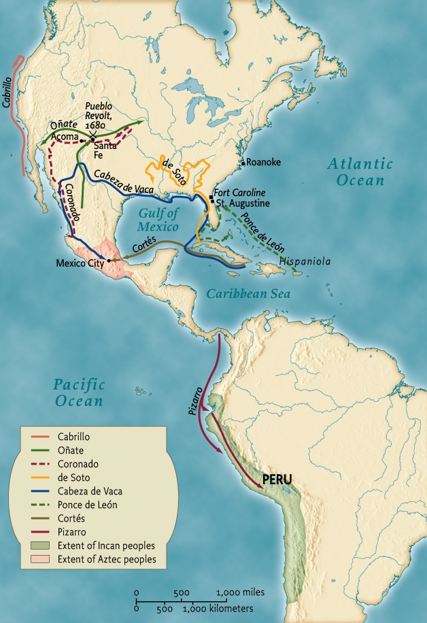
Early Spanish Conquests and Explorations
Map 1.5 Early Spanish Conquests and ExplorationsIn the New World Give Me Liberty!: An American History, 5th Edition
Copyright © 2017 W.W. Norton & Company
Notes:
By around 1600, New Spain had become a vast empire stretching from the modern-day American Southwest through Mexico and Central America and into the former Inca kingdom in South America. This map shows early Spanish exploration, especially in the present-day United States.

Slide 45
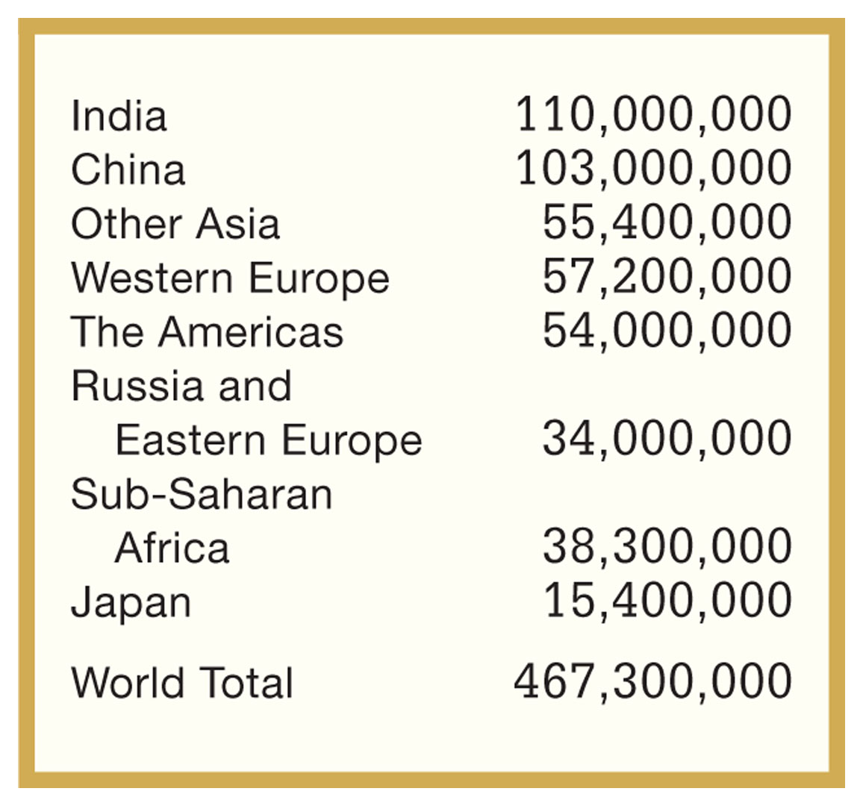
Estimated Regional Populations
Table 1.2 Estimated Regional Populations: The World, ca. 1500 Give Me Liberty!: An American History, 5th Edition
Copyright © 2017 W.W. Norton & Company

Slide 46
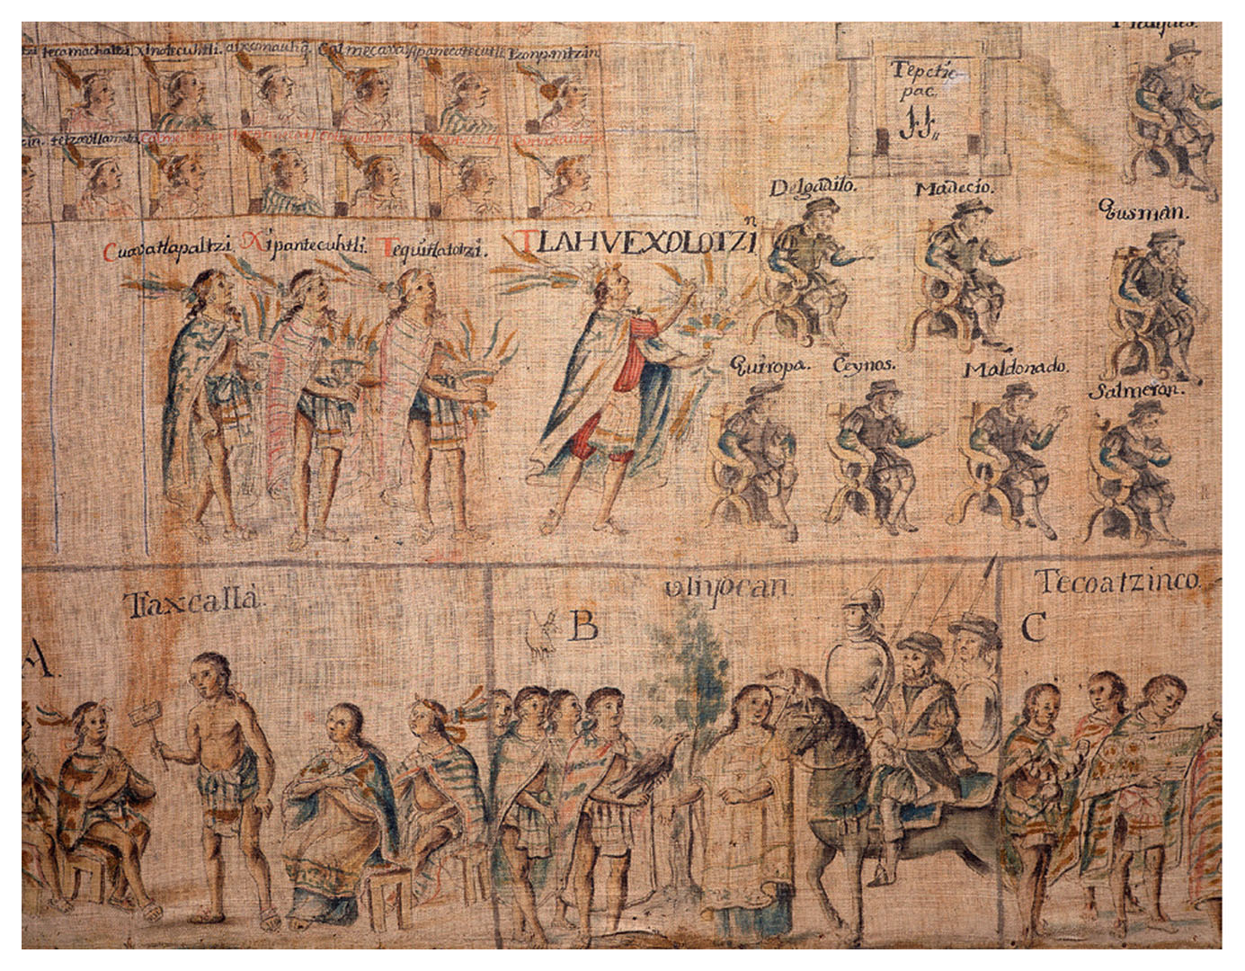
Spanish View Aztec Warrior Dance
An image from the Tlaxcala Codex Give Me Liberty!: An American History, 5th Edition
Copyright © 2017 W.W. Norton & Company
Notes:
An image from the Tlaxcala Codex, which chronicles events in a region of central Mexico in the sixteenth century. Aztec warriors dressed in eagle and jaguar costumes dance before Spanish officials and priests.

Slide 47
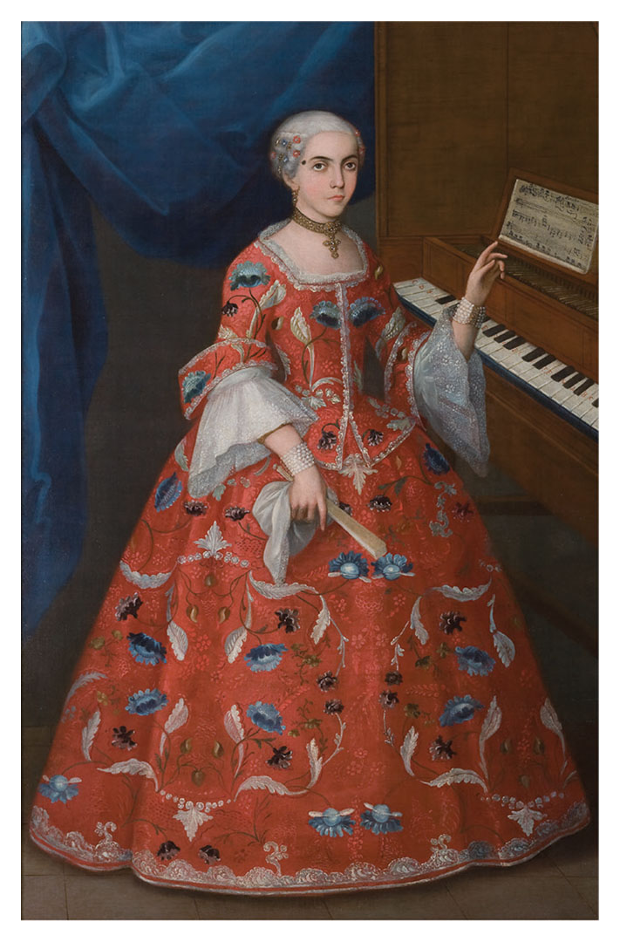
Young Woman with a Harpsichord
Young Woman with a Harpsichord Give Me Liberty!: An American History, 5th Edition
Copyright © 2017 W.W. Norton & Company
Notes:
Young Woman with a Harpsichord, a colorful painting from Mexico in the early 1700s, depicts an upper-class woman. Her dress, jewelry, fan, the cross around her neck, and the musical instrument all emphasize that while she lives in the colonies, she embodies the latest in European fashion and culture.

Slide 48
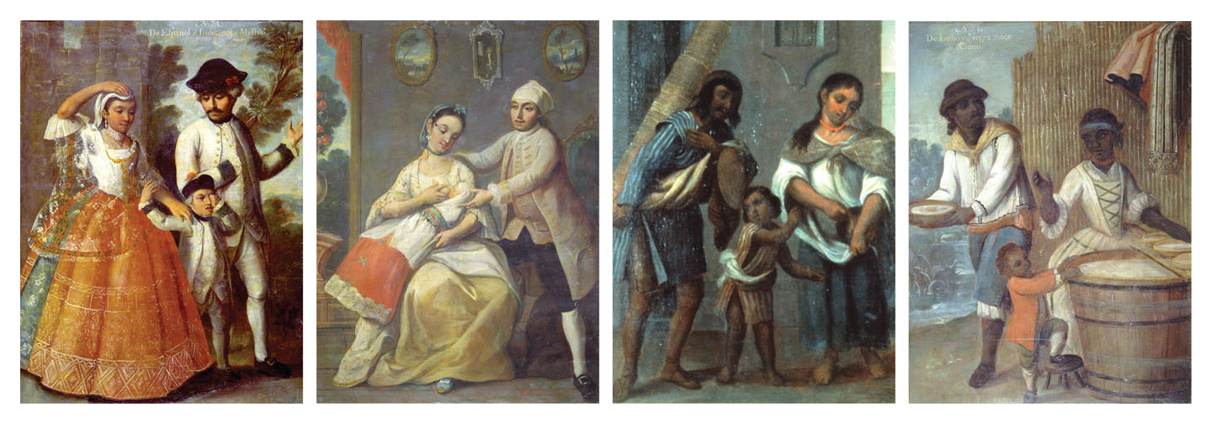
Four Racial Groups
Four Racial Groups Give Me Liberty!: An American History, 5th Edition
Copyright © 2017 W.W. Norton & Company
Notes:
Four Racial Groups, taken from a series of paintings by the eighteenth-century Mexican artist Andrés de Islas, illustrates the racial mixing that took place in the Spanish empire and some of the new vocabulary invented to describe it. First: The offspring of a Spaniard and Indian is a mestizo. Second: A Spaniard and a mestiza produce a castizo. Third: The child of an Indian and a mestiza is a coyote. Fourth: And the child of an Indian man and African woman is a chino.

Slide 49
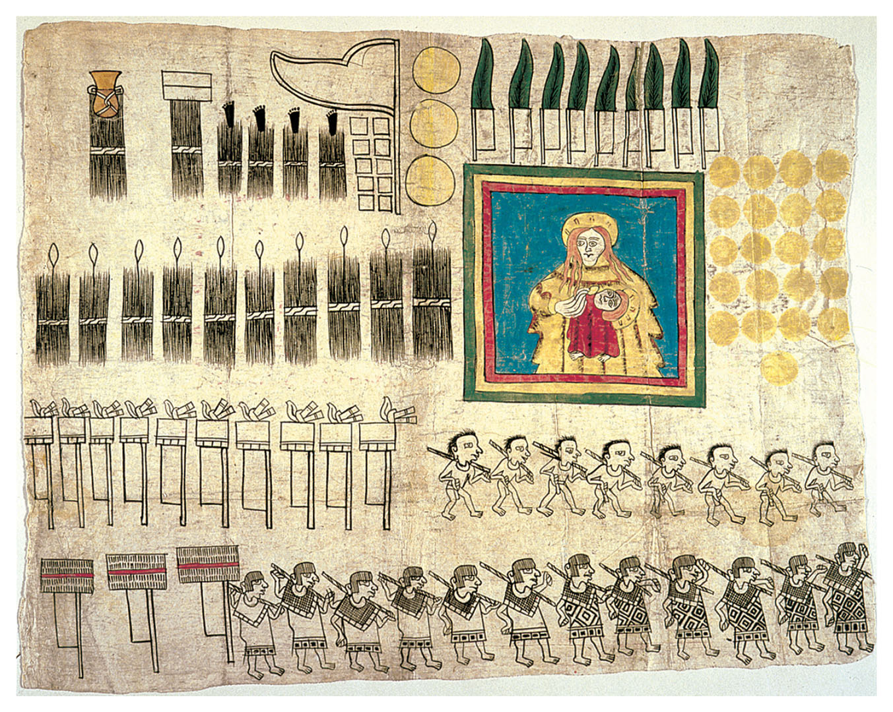
Taxes to Spanish Conquerors
Illustration from the Huexotzinco Codex, 1531 Give Me Liberty!: An American History, 5th Edition
Copyright © 2017 W.W. Norton & Company
Notes:
Note to Compositor: insert image from page 27, top of the page.
An illustration from the Huexotzinco Codex (1531) depicts Mexicans providing products and services as taxes to the Spanish conquerors. The banner of the Virgin Mary and baby Jesus reflects the early spread of Christianity. The people of Huexotzinco, a town near Mexico City, had aided Hernán Cortés in his conquest of the Aztec empire. The codex was part of a successful lawsuit, endorsed by Cortés, in which the Indians challenged excessive taxation by colonial officials.

Slide 50
Conquest and the Faith
Justifications for Conquest
Spreading the Faith
Las Casas’s Complaint
Notes:
Most Europeans believed in the inherent superiority of their cultures and societies over those of the Indians, and they rarely questioned their right to conquer them. Rather, they expected these societies to abandon their own cultures in favor of European culture. Before colonizing the New World, Europeans had fought each other in religious wars and conflicts, establishing a precedent for conquering other peoples and cultures based on religious and cultural notions of superiority and inferiority. Especially on Spain’s part, the colonizers felt justified in conquest by Pope Alexander VI’s granting of much of the Western Hemisphere to Spanish title.
The papal decree came with a potent message that the colonizers were responsible for spreading the Catholic faith in their dominions. The Spanish, in particular, embraced the mission to convert natives to Christianity. With the Protestant Reformation dividing the Catholic Church beginning in 1517, the Spanish believed they had to convert natives to Catholicism to save them from heathenism and Protestantism. At this early stage of colonization, the Spanish had no concept of “race” as an innate, unchanging characteristic, thus they hoped conversion would assist in their quest to assimilate the Indians and raise them to European levels of civilization. The drastic fall in Indian population due to epidemics and brutal forced labor systems hindered these efforts, but conquistadores saw no contradiction between missionizing and forced labor for personal and national profit.
Spanish colonizers saw Indians as a workforce for extracting gold and silver to enrich Spain, and in the process worked many of the Indians to death. The Spanish believed they were giving the Indians “freedom” through Christian conversion, while they also exploited them to make Spaniards and the Spanish crown immensely rich. Pope Paul III outlawed American Indian enslavement (though not African enslavement), and Bartolomé de Las Casas preached against the injustices committed against American Indians. But Las Casas, like Pope Paul III had no qualms with African slavery; rather, he viewed African slavery as a way to avoid the brutalities being committed upon the Indian population.

Slide 51
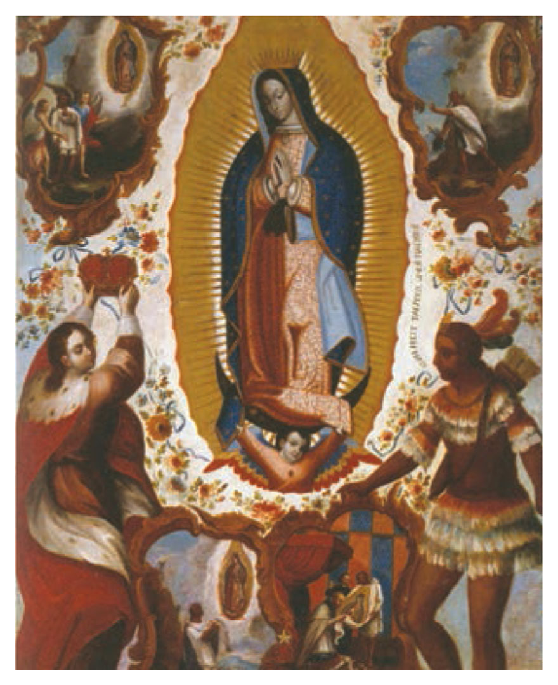
The Virgin of Guadalupe
The Virgin of Guadalupe, a symbol of Mexican culture, in an image from 1770. Give Me Liberty!: An American History, 5th Edition
Copyright © 2017 W.W. Norton & Company
Notes:
The Virgin of Guadalupe, a symbol of Mexican culture, in an image from 1770. She is portrayed as the protector of the Indians.

Slide 52
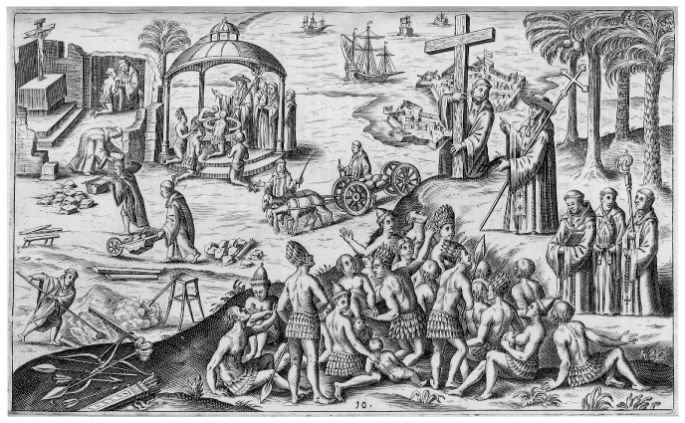
A Benign View of Spanish Colonization
Engraving, 1621 Give Me Liberty!: An American History, 5th Edition
Copyright © 2017 W.W. Norton & Company
Notes:
A benign view of Spanish colonization. This engraving from a 1621 book depicts Spanish missionaries bringing Christianity to New World natives while priests do construction work. A fortified colonial town is visible in the background.

Slide 53
Reform
Reforming the Empire
Notes:
In 1542, Spain’s “New Laws,” stemming from Pope Paul III’s command and Las Casas’s efforts, officially outlawed Indian slavery. Las Casas criticized his fellow Spaniards for their shocking atrocities and cruelties against native peoples, opposed their enslavement, and insisted that Indians were rational beings, not savages, who could not be denied their freedom and lands—even while he suggested that the importation of African slaves might protect Indians from exploitation. Las Casas’s criticisms helped spread throughout Europe the “Black Legend” of Spain as an exceptionally brutal and exploitative colonial power.
Las Casas and other Spaniards believed that colonists’ cruel treatment of the natives undermined their empire’s mission to convert and assimilate them. But some Spanish colonists resisted imperial reforms, such as the outlawing of Indian slavery, by rebelling against the crown. In 1550, the Spanish abolished the encomienda system, in which Spanish colonists had the right to rule over conquered Indian lands and force Indians to work, and replaced it with the repartimiento system, in which Indians were legally free and entitled to wages but were still required to perform annually a fixed amount of labor. No longer slaves, Indians were still exploited by landlords and priests.
Spain’s treatment of American Indians improved marginally as they came to include education, medical care, and European goods into their modes of colonization, in addition to violence and disease. Nonetheless, the “Black Legend” had taken hold, and it provided potent justifications for other European nations to challenge Spain’s dominance.

Slide 54
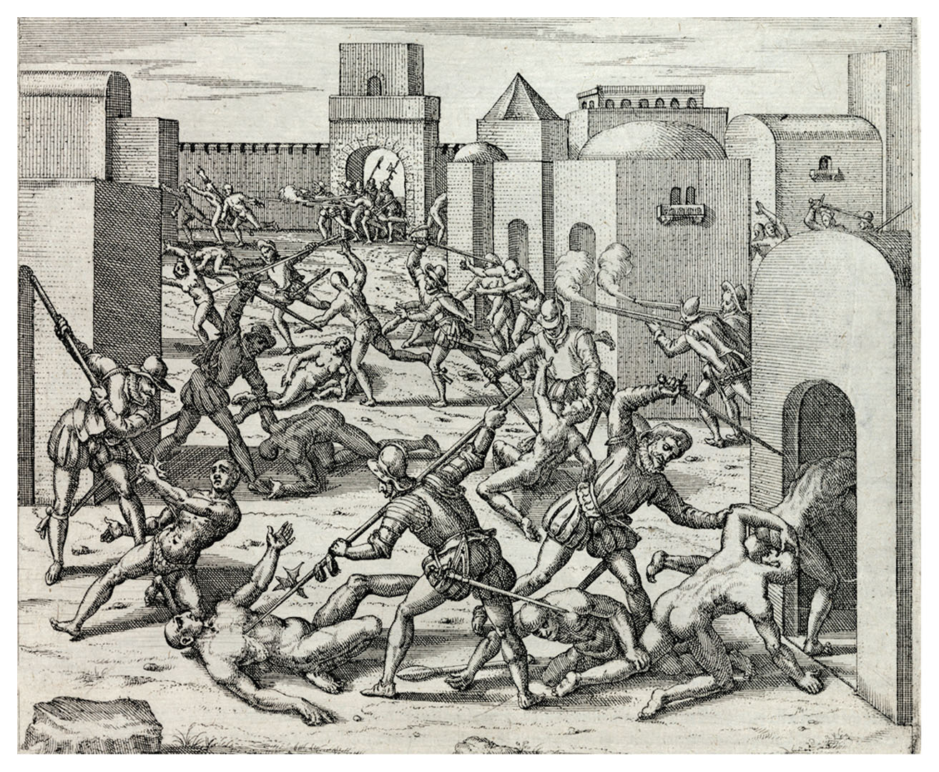
Spanish Conquistadores Murdering
American Indians
Spanish conquistadores murdering Indians Give Me Liberty!: An American History, 5th Edition
at Cuzco, in Peru Copyright © 2017 W.W. Norton & Company
Notes:
Spanish conquistadores murdering Indians at Cuzco, in Peru
The Dutch-born engraver Theodor de Bry and his sons illustrated ten volumes about New World exploration published between 1590 and 1618. A Protestant, de Bry created vivid images that helped to spread the Black Legend of Spain as a uniquely cruel colonizer.

Slide 55
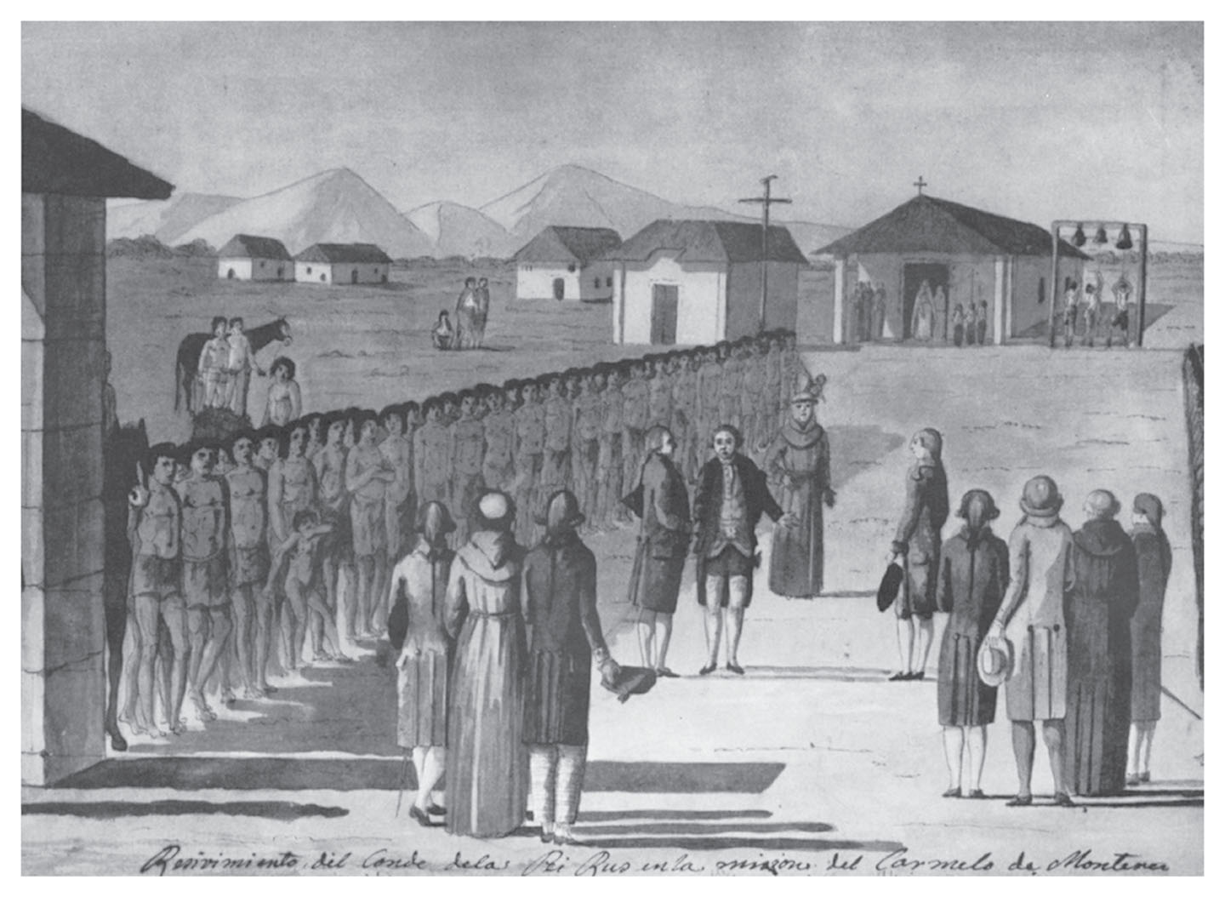
San Carlos Borromeo de carmelo
San Carlos Borromeo de Carmelo, or Give Me Liberty!: An American History, 5th Edition
Mission Carmel, 1786. Copyright © 2017 W.W. Norton & Company
Notes:
A view of San Carlos Borromeo de Carmelo, or Mission Carmel, in 1786, two years after the death of Father Junipero Serra, depicts Native Americans lined up to welcome a French scientific expedition. Sketched by a French explorer, this is the earliest known image of California.

Slide 56
Northern Exploration
Exploring North America
Notes:
Spanish explorers seeking new kingdoms of gold first came in the early sixteenth century to the areas that would become the United States, exploring the Pacific and Gulf coasts and parts of the American southeast and southwest. Additionally, the first colony was not in Jamestown or St. Augustine, but in Puerto Rico. Expeditions led by numerous Spanish explorers spread disease and devastation among Indian communities in North America; Hernando de Soto’s journey through the Gulf Coast and southwest was especially brutal. Raping, torturing, and enslaving native peoples they encountered, de Soto’s men also spread fatal diseases, all of which led to the virtual disappearance of once-vibrant native communities.

Slide 57
Northern New Spain
Spanish Florida
Spain in the Southwest
The Pueblo Revolt
Notes:
The first area to be colonized by the Spanish in what became today’s United States was Florida, where the Spanish wiped out French settlers in their hopes of preventing further French colonization and ending piracy in nearby waters. Despite considerable Spanish efforts to build towns and forts and convert Indians, the Spanish presence in Florida remained small.
In the southwest in 1598, the first major Spanish expedition in the area, led by Juan de Oñate, searched for fabled minerals, but when attacked by natives of Acoma in present-day New Mexico, they retaliated by killing and enslaving native inhabitants; women and children were consigned to forced servitude, while men were subjected to the cutting off of one foot. Oñate was recalled by Spanish authorities for his brutal methods and failure to find gold, and a period of more stable colonial rule was initiated with the establishment of New Mexico and its capital, Santa Fe.
By 1680, a small number of mostly mestizo Spanish colonists ruled over the Pueblo Indians of New Mexico. Tensions arose over the colonists’ exploitation of the Indians’ labor and their increasingly harsh efforts to convert Indians and eliminate indigenous religious practices and beliefs. Among other factors, this led to a successful revolt that year that drove the Spanish from New Mexico and restored native autonomy.
Led by Popé, a religious leader who had earlier been arrested by the Spanish for “sorcery,” the Pueblos attacked and nearly wiped out the entire population of Spanish colonists, destroying in the process all the symbols and icons of Spanish culture and Catholicism they could find. A dozen years later, cooperation between Pueblo peoples disintegrated, and the Spanish reconquered New Mexico for good. The Pueblo Revolt was the most complete victory for Native Americans over Europeans and the only wholesale expulsion of settlers in the history of North America. Though victorious in the end, the incident caused Spain to rethink its practices, and institute more tolerance for traditional religion as well as a decreased demand on Indian labor in the eighteenth century.

Slide 58
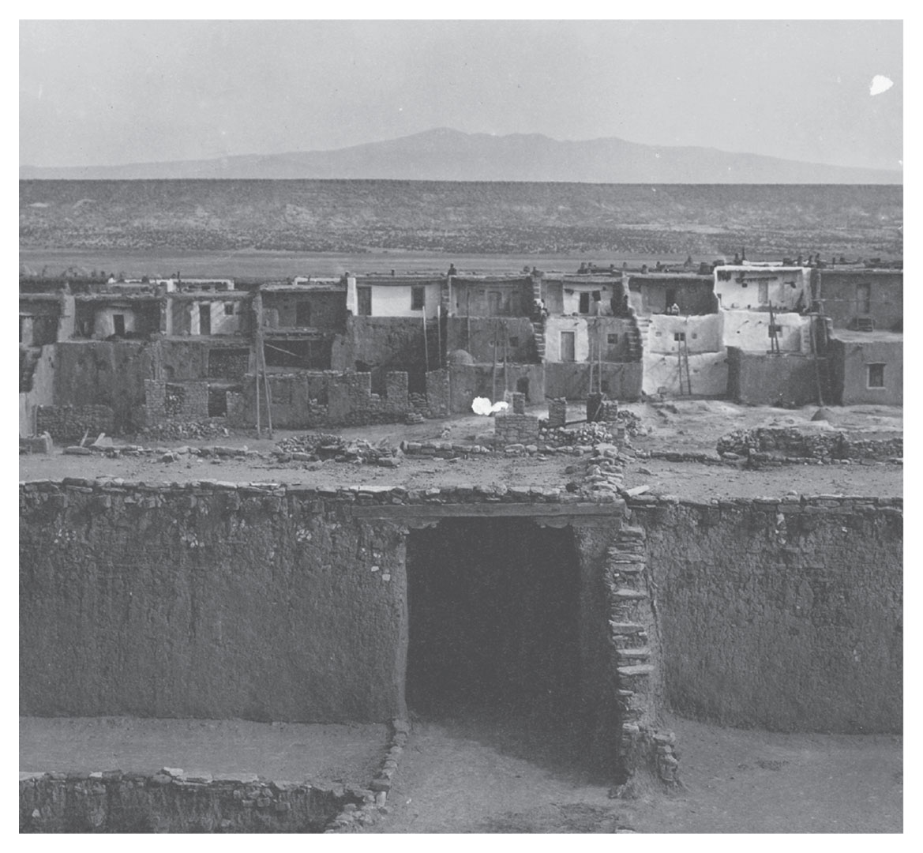
Acoma, the “Sky City”
Acoma, the “Sky City” Give Me Liberty!: An American History, 5th Edition
Copyright © 2017 W.W. Norton & Company
Notes:
Acoma, the “sky city,” as it appeared in 1904.

Slide 59
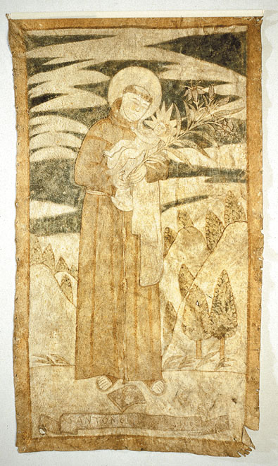
St. Anthony and the Infant Jesus
St. Anthony and the Infant Jesus Give Me Liberty!: An American History, 5th Edition
Copyright © 2017 W.W. Norton & Company
Notes:
St. Anthony and the Infant Jesus, painted on a tanned buffalo hide by a Franciscan priest in New Mexico in the early eighteenth century. This was not long after the Spanish reconquered the area, from which they had been driven by the Pueblo Revolt.

Slide 60
Focus Question: The French and Dutch Empires
  Focus Question:
  What were the chief features of the French and Dutch empires in North America?
Notes:
The purpose of the focus questions is to help students find larger themes and structures to bring the historical evidence, events, and examples together for a connected thematic purpose.
As we go through each portion of this lecture, you may want to keep in mind how the information relates to this larger thematic question. Here are some suggestions: write the focus question in the left or right margin on your notes and as we go through, either mark areas of your notes for you to come back to later and think about the connection, OR as you review your notes later (to fill in anything else you remember from the lecture or your thoughts during the lecture or additional information from the readings), write small phrases from the lecture and readings that connect that information to each focus question AND/OR are examples that work together to answer the focus question.

Slide 61
New France
French Colonization
New France and the Indians
Notes:
Even as other European powers disdained Spain’s treatment of the Indians, they aspired to match the Spanish empire’s incredible mineral wealth. With the balance of economic power altered by Spain’s success, rival French, Dutch, and English colonists established colonies in North America during the seventeenth century.
The French were first, hoping to find gold and locate a Northwest Passage to the Pacific. Failed initial settlements were followed by permanent settlements in the Mississippi River valley and along the St. Lawrence River in what became Canada, then called New France. But fears that France’s large population, its main advantage against England, would be depleted by colonial settlement kept emigration low. Furthermore, negative reports of the conditions and opportunities in North America dissuaded many from making the journey.
Few in number and embracing the fur trade rather than agriculture, however, French colonists depended on friendly relations with local Indians. The French prided themselves on being more humane than rival empires. Not interested in land as were English colonists, or in exploiting Indian labor as had the Spanish, the French created elaborate military, commercial, and diplomatic connections with natives, creating alliances with Indians unparalleled in North America in their durability. Samuel de Champlain emphasized tolerance and denied that Indians were inferior to Europeans, and though French Jesuits sought to convert the Indians, the French generally were more tolerant of Indian religions and spiritual practices than rival European colonists. In the “middle ground” of the upper Great Lakes region, French and Indians mixed in relative equality. Though Indians were encouraged to adopt European customs, it was more common for settlers to adopt the “free” life of the Indians.
But French colonialism all the same brought disease and warfare to native populations, especially as the fur trade and the introduction of European commodities intensified conflicts between native groups and as wars between European colonists on the continent embroiled natives allied to different European powers.

Slide 62
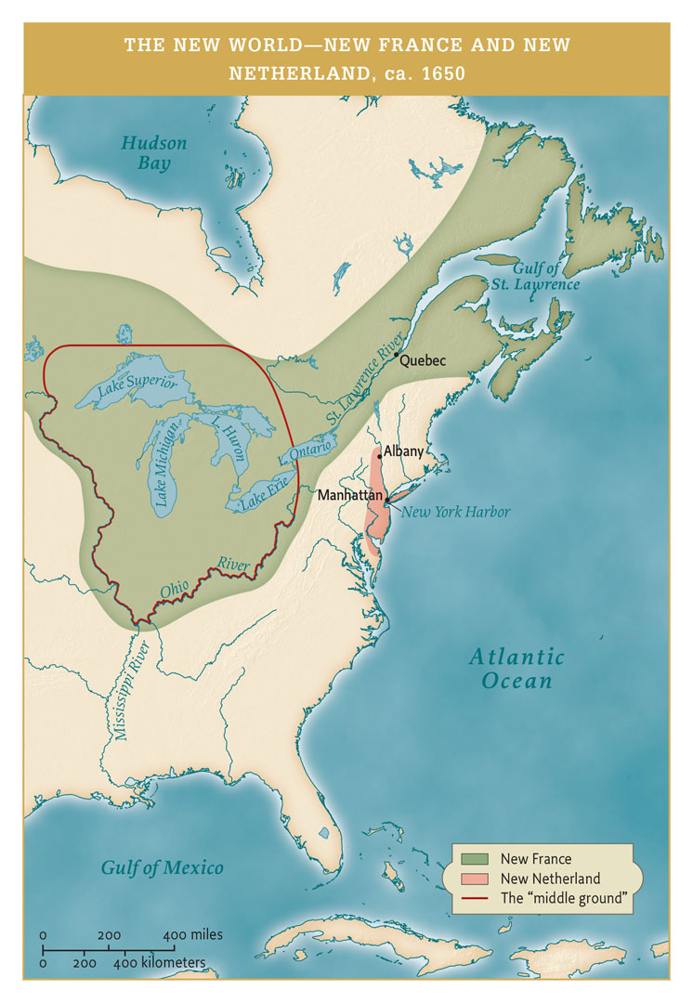
New France and New Netherland
Map 1.6 The New World—New France and New Netherland, ca. 1650 Give Me Liberty!: An American History, 5th Edition
Copyright © 2017 W.W. Norton & Company
Notes:
New France and New Netherland

Slide 63
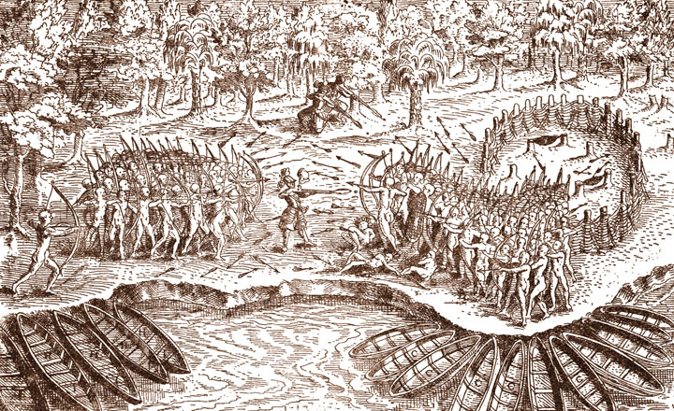
Samuel de Champlain
Engraving in Samuel de Champlain’s account of his voyages, 1613 Give Me Liberty!: An American History, 5th Edition
Copyright © 2017 W.W. Norton & Company
Notes:
This engraving, which appears in Samuel de Champlain’s 1613 account of his voyages, is the only likeness of the explorer from his own time. Champlain, wearing European armor and brandishing an arquebus (an advanced weapon of the period), stands at the center of this pitched battle between his Indian allies and the hostile Iroquois.

Slide 64
Dutch Imperialism
The Dutch Empire
Dutch Freedom
Notes:
The Dutch first came to the New World in 1609 with Henry Hudson’s exploration of New York Harbor and the river that would come to bear his name, setting the stage for the establishment in 1624 of New Amsterdam, the Dutch outpost on Manhattan that became the basis for New York. Although small in size and population, the Netherlands was the center of a global maritime empire of trade, culture, and enlightenment, and the Dutch invented practices, such as the joint stock company, that were critical to the birth of modern capitalism.
The Dutch prided themselves on their devotion to liberty; in Europe, no other country aside from the Netherlands had established freedom of the press or the right to private religious practice. The Dutch Reformed Church was the official national church, but individuals were free to choose their religious preference. That freedom led people from all over Europe to seek religious and economic refuge among the Dutch, and many of those people would eventually settle in the Dutch colonies.

Slide 65
Freedom and Toleration
Freedom in New Netherland
The Dutch and Religious Toleration
Settling New Netherland
New Netherland and the Indians
Borderlands and Empire in Early America
Notes:
Though the Netherlands was exceptional in its commitment to freedom of the press and religious toleration, New Netherland was hardly governed democratically. New Amsterdam was ruled by the West India Company and lacked an elected assembly or a town council, both of which were common in the Netherlands at the time. But Dutch slaves here had some rights: they were given land to support their families, but had to pay an annual fee to the Company and work for the Company when called upon. Slaves in New Netherland worked on family farms or in craft labor rather than in a plantation system such as that in the West Indies. Women also experienced more freedom than in other colonies; Dutch law allowed women to retain separate legal identities from husbands, to borrow money, own property, and expect to be included in wills aside sons.
New Netherland attracted a diverse array of settlers from different areas of the world, and of course that included the practice of a variety of religions. The Dutch were more tolerant of other religions than other colonial communities in other areas of the Americas, but it is important to note that the official religion of both Holland and New Netherland was the Dutch Reformed Church. Thus, while more tolerant of religious diversity, New Netherland was not completely devoid of conflict over religion. Restrictions on openly practicing other religions besides that of the Dutch Reformed Church were denied by government officials, and in some instances those who protested the restrictions were arrested for defiance. The freedom was of religious practice in private, but not public. Officials and colonists were expected to defend the Dutch Reformed faith in New Netherland. Nonetheless, religious freedom was more extensive than in other empires.
The West India Company gradually loosened its control over New Netherland and offered incentives for settlement, including large estates for patroons, shareholders who agreed to transport tenants for agricultural labor. Several patroons established large estates where they ruled autocratically over their tenants, leading to rebellions in the eighteenth century as freehold tenure became common. Despite the best efforts of its rulers to attract settlers, however, New Netherland remained a tiny outpost in a global Dutch empire.
The Protestant Dutch, interested in trade rather than conquest and having recently liberated themselves from Spanish rule over the Netherlands, generally identified with the Indians as fellow victims of Spanish and Catholic oppression. They recognized Indian sovereignty over the land, and forbade Dutch settlement until legal title to the land had been purchased from the Indians. But the Dutch also required tribes to pay them, and Dutch settlers provoked conflict with local Indians.
A “borderland,” according to one historian, is “a meeting place of peoples where geographical and cultural borders are not clearly defined.” Many of these areas developed during European settlement, such as the Great Lakes region in New France. Overlapping claims to authority and hybrid cultures developed in these areas. Europeans generally consolidated their power at the expense of American Indian power, but at the edges of empire, power and culture dynamics were unstable. European claims often competed against one another, and American Indians often skillfully played these groups against one another, thus increasing their own power at certain points. The types of settlements were therefore different dependent upon which colonizing power established them. All colonizers brought some form of Christianity, new technology, legal/family relations, types of warfare, and disease. Dreams of freedom for European and Indian alike through the spread of Christianity was continually cited as justification for conquest and colonization. England entered the fold at the outset of the seventeenth century under the same pretenses.

Slide 66
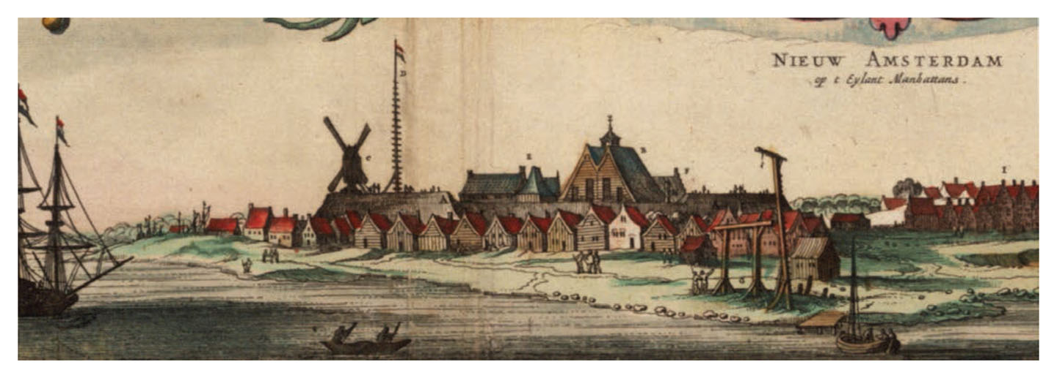
New Amsterdam
New Amsterdam, 1651 Give Me Liberty!: An American History, 5th Edition
Copyright © 2017 W.W. Norton & Company
Notes:
A view of New Amsterdam from 1651 illustrates the tiny size of the outpost.

Slide 67
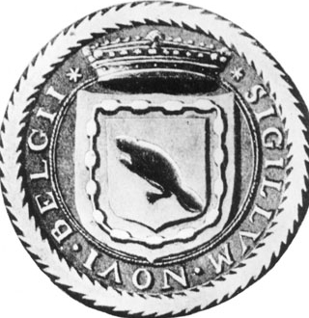
Seal of New Netherland
The seal of New Netherland, adopted by the Dutch West India Company in 1630 Give Me Liberty!: An American History, 5th Edition
Copyright © 2017 W.W. Norton & Company
Notes:
The seal of New Netherland, adopted by the Dutch West India Company in 1630, suggests the centrality of the fur trade to the colony’s prospects. Surrounding the beaver is wampum, a string of beads used by Indians in religious rituals and as currency.

Slide 68
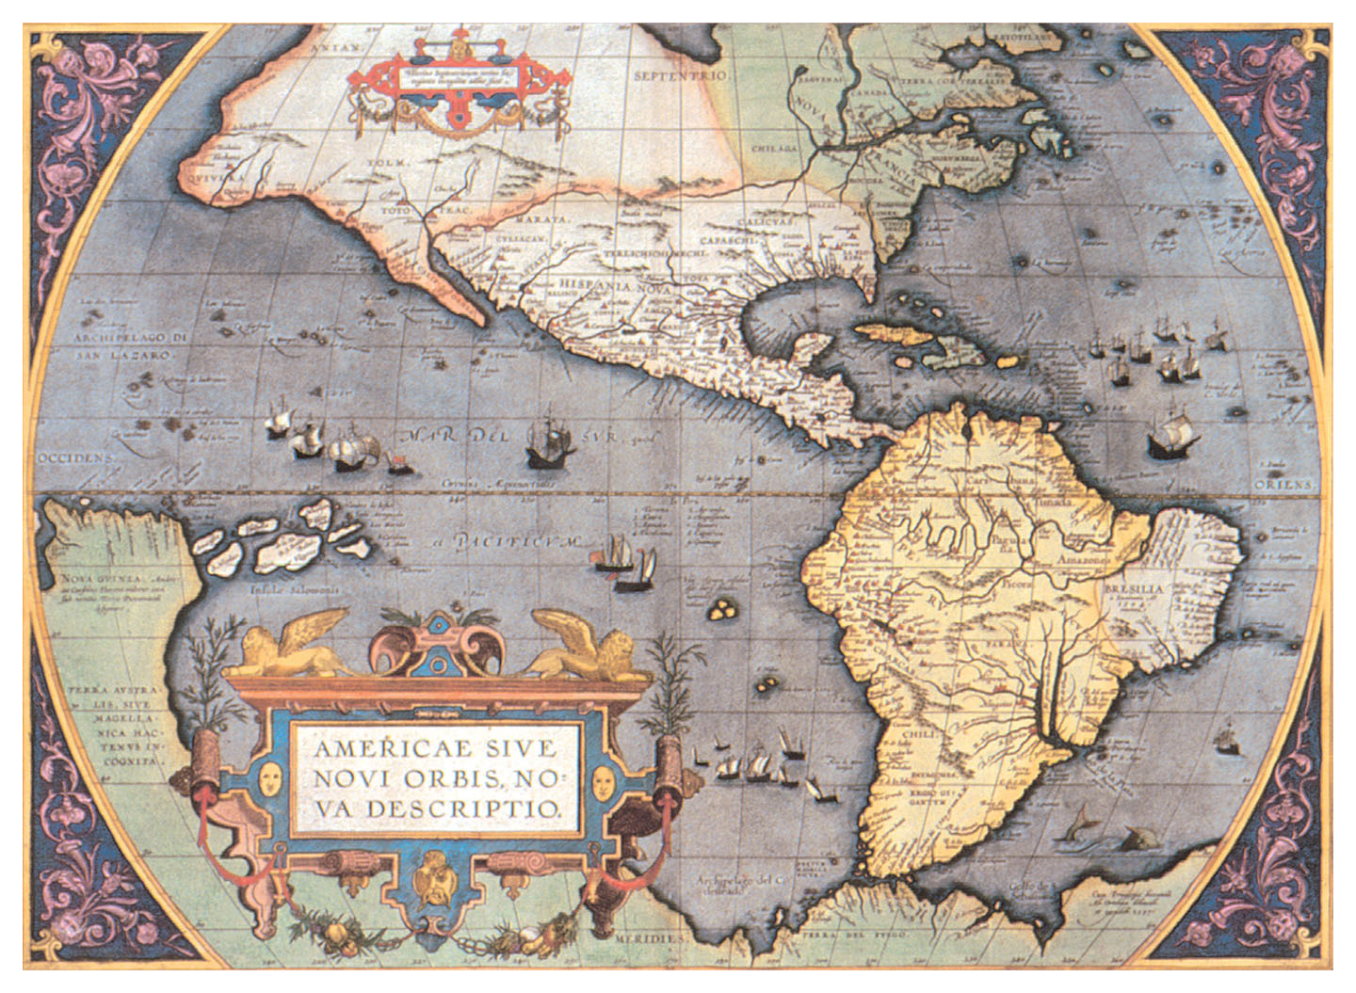
Empire in the Western Hemisphere, 1592
The Western Hemisphere, 1592 Give Me Liberty!: An American History, 5th Edition
Copyright © 2017 W.W. Norton & Company
Notes:
A map of the Western Hemisphere, published in 1592 in Antwerp, then ruled by Spain and now part of Belgium. It shows North America divided between New France and New Spain before the coming of the English.

Slide 69
Review: Part One
The First Americans
  Focus Question: What were the major patterns of Native American life in North America before Europeans arrived?
Indian Freedom, European Freedom
  Focus Question: How did Indian and European ideas of freedom differ on the eve of contact?
The Expansion of Europe
  Focus Question: What impelled European explorers to look west across the Atlantic?

Slide 70
Review: Part Two
Contact
  Focus Question: What happened when the peoples of the Americas came in contact with Europeans?
The Spanish Empire
  Focus Question: What were the chief features of the Spanish empire in America?
The French and Dutch Empires
  Focus Question: What were the chief features of the French and Dutch empires in North America?

Slide 71
MEDIA LINKS
—— Chapter 1 ——
Title | Media links
Eric Foner on freedom, pt. 1: how English settlers were inspired by freedom | Pt 1: How English Settlers Were Inspired by Freedom
Eric Foner on freedom, pt. 2: differing views of freedom among the American colonies | Pt 2: Differing Views of Freedom Among the American Colonies
Eric Foner on freedom, pt. 3: settlers and the Indians | Pt 3: Settlers and the Indians
Eric Foner on freedom, pt. 4: settlers and the Indians | Pt 4: Settlers and the Indians
Eric Foner on freedom, pt. 5: freedom in the 15th and 16th centuries | Pt 5: Freedom in the 15th and 16th centuries
Eric Foner on freedom, pt. 6: new ideas of freedom after the English Civil War | Pt 6: New Ideas of Freedom after the English Civil War

Slide 72
Next Lecture PREVIEW:
—— Chapter 2 ——
Beginnings of English America, 1607–1660
England and the New World
The Coming of the English
Settling the Chesapeake
The New England Way
New Englanders Divided
Religion, Politics, and Freedom

Slide 73
This concludes the Norton Lecture Slide Set for Chapter 1
Give Me Liberty!
AN AMERICAN HISTORY
FIFTH EDITION by
Eric Foner
Norton Lecture Slides
Independent and Employee-Owned

